Slide 1


Accelerating Digital Transformation
Author
Title
Pivotal Cloud Foundry
Notes:
Resting slide on screen before you begin presenting.

Slide 2

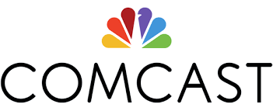



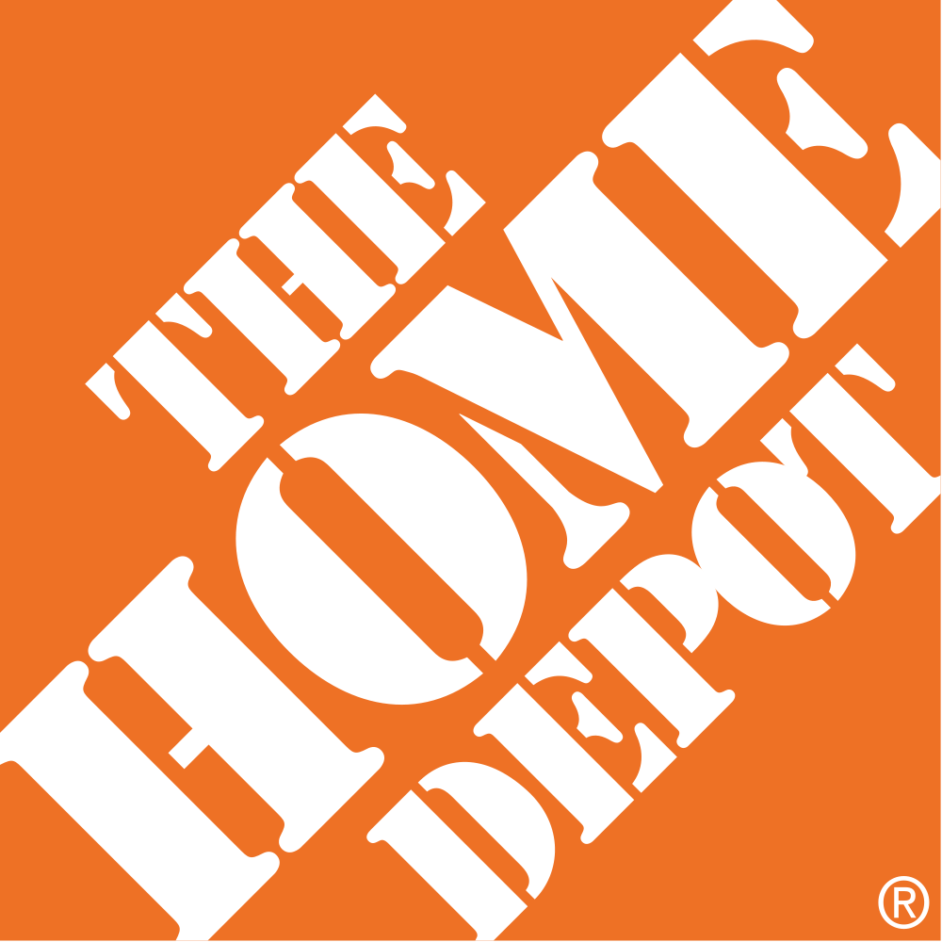
Software is changing INDUSTRIES
$26BN
Insurance/Financial Services
$162BN
Entertainment
Pivotal Customers
$50BN
Automotive
$27BN
Healthcare
$280BN
Industrial
$169BN
Home Improvement
Notes:
SOFTWARE IS EATING THE WORLD
Expanding Internet access and mobile device proliferation are empowering users with increased efficiency and new and delightful experiences. As a result, software is emerging as a differentiating and disruptive force in businesses across every industry.
The Upstarts
Nimble competitors who judiciously leverage software enabled speed and scale are increasingly able to secure and retain customers by penetrating traditional barriers of entry or creating entirely new markets. This trend is most easily visible in the new generation of technology driven companies that have rapidly risen to prominence. You have probably heard some version of the story where several Silicon Valley companies are disrupting traditional industries and creating tremendous value. For example,
Uber has no cars
AirBnB owns no real estate
Facebook doesn’t generate content
Yet, they have all seen tremendous success and large valuations.
Not Just For the Upstarts
But, this “software driven” trend is not just for the upstarts. Traditional leaders such as Allstate, Ford, Comcast and Humana across various industry verticals are pursuing digital transformations that leverage software to streamline and redefine their businesses, and reshape their industries in the process. There exist new opportunities enabled by software, and most enterprises today are grappling with how to capture new markets and defend existing ones with (and from) software.
AppDev has a Strategic Mandate
Thus, software – the ability to develop, deploy and operate it with speed and reliability – is steadily becoming the distinguishing characteristic of enterprises able to release innovative functionality quickly, to retain and grow customer bases. It is clear that you need to be good at software to capture these opportunities and to succeed in modern business. Thus, AppDev has a strategic role to play in business success and has a mandate to be an innovation center to enable the business to transform and succeed in a software driven world.
Pivotal – Your Strategic Partner
Pivotal has been helping enterprises excel at developing software for a long time. Today, Pivotal is at the forefront of digital transformation and helping transform how software is built and delivered by the world’s most demanding enterprises. Here are a few customers that have successfully partnered with Pivotal to transform their software practice and position their business to capture new opportunities.

Slide 3



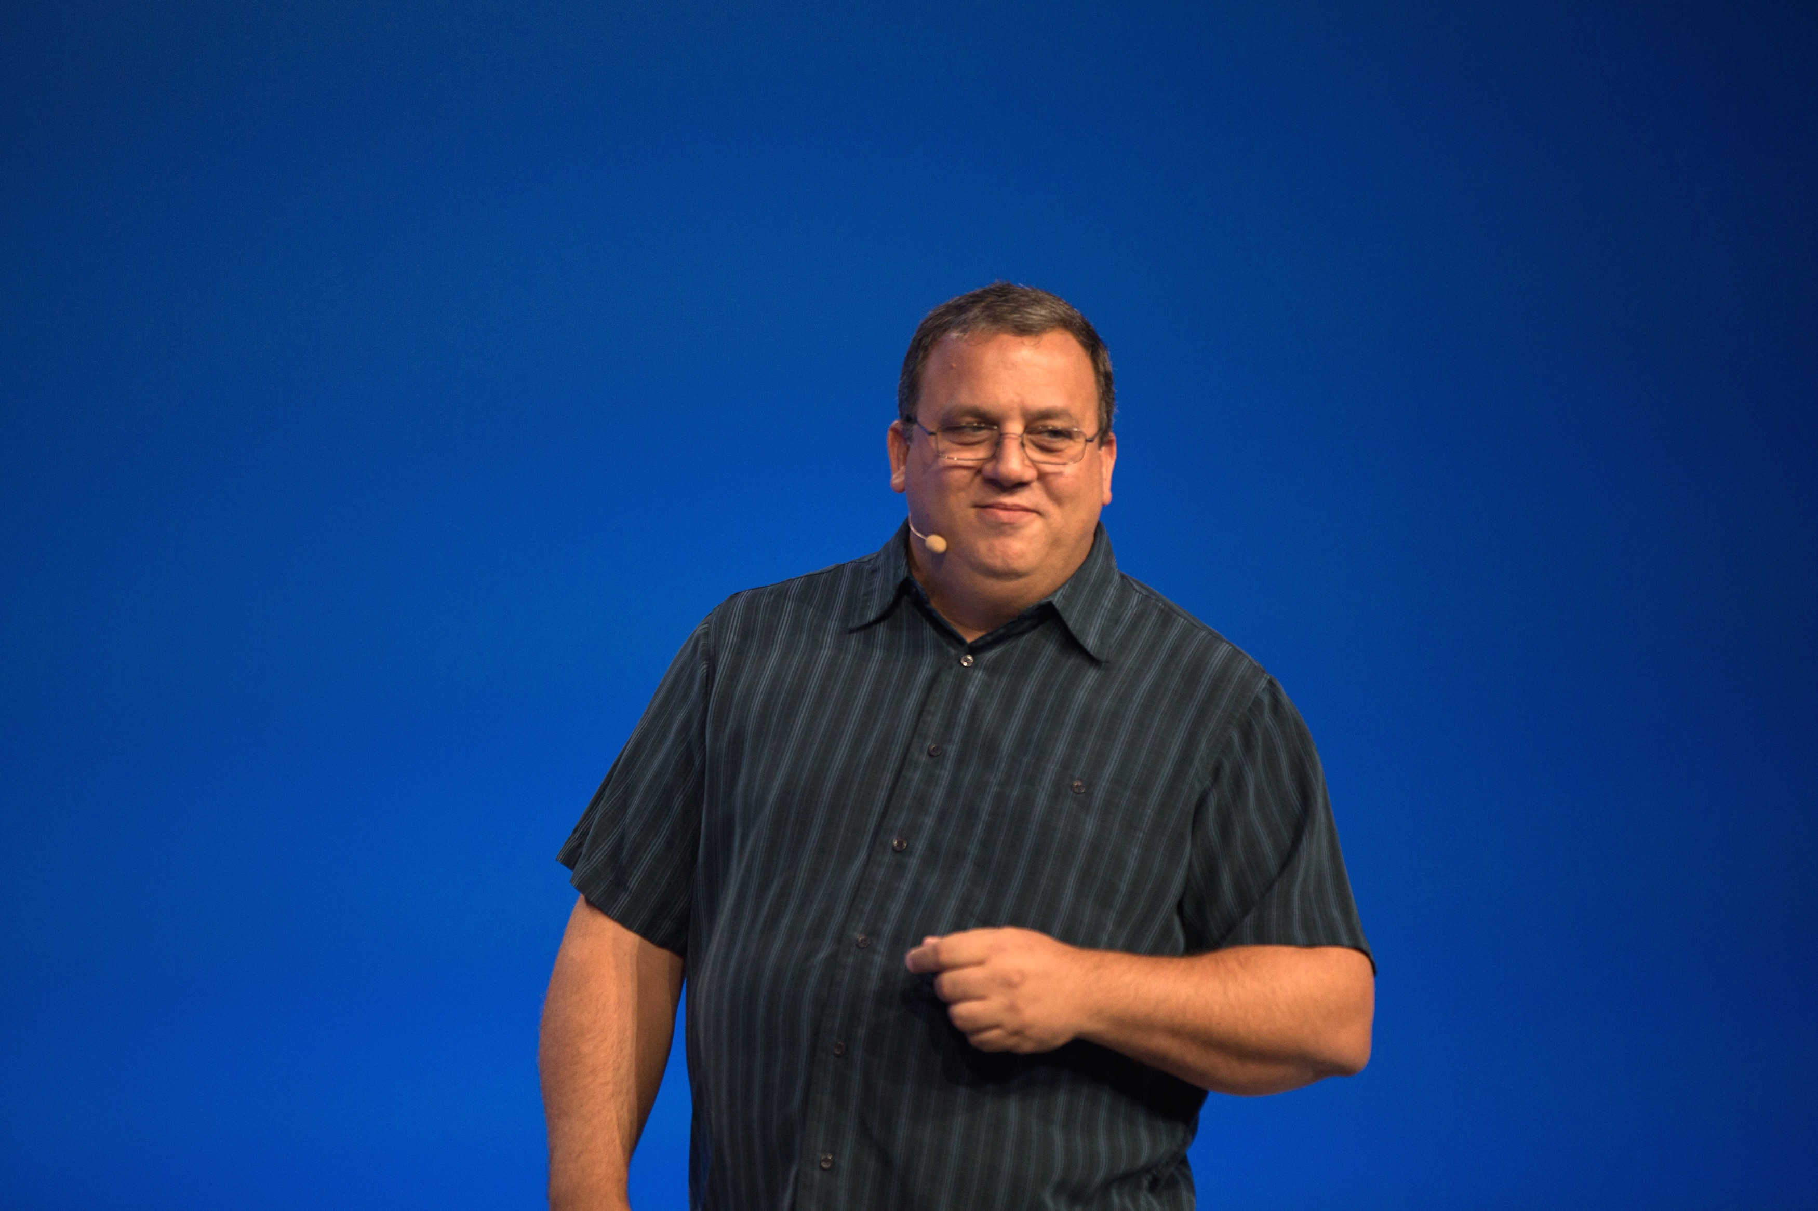
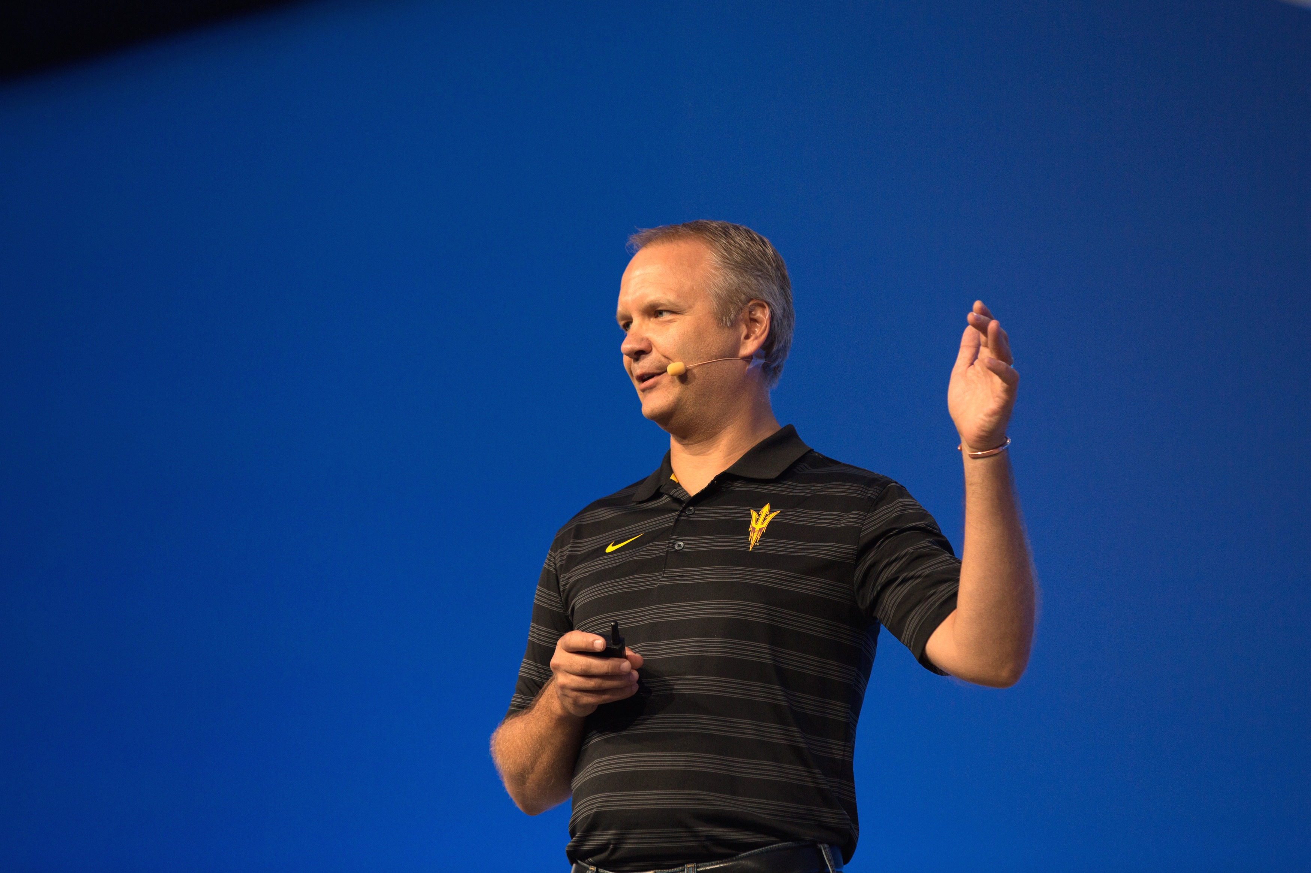



Speed is Critical in Modern Software
Notes:
SPEED IS CRITICAL IN MODERN SOFTWARE
AppDev Has a Challenging Mandate
The AppDev organization has a challenging mandate. It must develop software that meets the needs of multiple stakeholders (e.g., end-user, line of business, engineering and operations teams) that have their own unique set of priorities. These complex requirements lead to equally complex software (see appendix slide). However, more importantly, it must develop functionality that can be quickly delivered to the user. Further, in the service-oriented world of cloud, new functionality and updates to existing functionality, must be delivered without disruption to users.

Slide 4
Optimizing Time to Value
Adrian Cockcroft
VP, Cloud Architecture
Amazon Web Services
Previously Netflix Cloud Architect
Idea
Production
Time to Value → 0
Maximize
Customer Learning
Minimize
Competitive Entry
Adapt To
Market Shifts
Notes:
SPEED IS CRITICAL IN MODERN SOFTWARE
Time to Value Is Key Metric to Optimize
Adrian Cockroft, the chief software architect for Netflix’s microservices based architecture (one of the first software driven disruptors) who recently joined Amazon as VP of Cloud Architecture, has captured the above challenge succinctly in the notion of “Time to Value.” Cockroft argues that modern software driven enterprises should focus on optimizing the amount of time it takes to get software in front of users – the time to value. Only after it is in front of users, does it begin to add value to the customer and become a source of valuable feedback to the AppDev organization. Thus, speed of software delivery to production becomes critical. AppDev organizations should strive to minimize the time to value. See here for more info: https://www.youtube.com/watch?v=DGK6jjamzfY (21:22).
Benefits of Optimizing Time to Value
Speed enables businesses to capture customers through innovative functionality before competitors can. It also enables enables them to gather customer feedback sooner, so they can learn, iterate and better meet customer requirements sooner than the competition. With more businesses being conducted through software driven experiences, developing and shipping software with speed is critical to success in a software driven business. Unfortunately, most enterprises software cycles are too long and fraught with friction, resulting in large gaps between releasing new iterations of software. As a result, it exposes enterprises various types of risk:
Customer Flight: Customers may leave because the software no longer adds value or no longer provides a new and engaging experience.
Competitive Entry: Large gaps between new feature releases enable more nimble competitors to enter with innovative functionality and steal market share, or capture new opportunity
Market Shift: Customer/market requirements shift because of changing needs, new trends, competitive entry, etc. Slow software cycles make it difficult for enterprises to pick up on shifting requirements. When software is eventually released, the market does not receive it well since the market changed faster than the software release cycle.
As a result, software driven enterprises need to ensure application development and delivery speed in order to remain competitive.
Pivotal has helped many customers achieve this speed.

Slide 5
“
No longer are you waiting 6 months to launch a product. You are going to conceive a product on a Monday and launch it on a Friday. That usually took 9 months at best.
”
Andy Zitney
SVP, Infrastructure
AllState
Notes:
Allstate Digital Transformation
Pivotal helped Allstate transition from a company that waited close to 100 days to provision infrastructure for their developers to one that allowed developers to release new features within days of conceptualizing them and could scale applications in minutes. That means, developers are able to rapidly provision infrastructure, develop new code, test the software, and push it to production in a small fraction of the time that it used to before.
Vertical: Insurance
Company: 2nd largest personal lines insurer in USA and largest that is publicly held (2016 Revenue: ~$35B , 40K employees). Awards like Top 10 innovator of the decade (Information Week), “America's Most Admired Companies”, Top 50 Companies for Diversity etc.
Threat: Growth in insurance startups & autonomous car could possibly disrupt their currently very healthy business
Challenge: Technology/process update needed to avoid non-value added work, increase agility, and system resilience
Action: Worked with Pivotal to train their staff on new methodologies and PCF. Deployed Pivotal Cloud Foundry to run existing and new applications.
Results:
Developers went from working on code only 20% of time to 80-90% of their time.
New environment provisioning went from 60hrs to 30 mins
Innovation capacity went from 5% to 80%
Enhanced consistency and speed of IT workflows
Videos:
Cloud Foundry Summit 2015: https://www.youtube.com/watch?v=04QFKBt6LCI&list=PLhuMOCWn4P9g-UMN5nzDiw78zgf5rJ4gR&index=15

Slide 6

Idea to Feature: 2-3 Days
“
The time it takes to deliver a new feature when there is a new idea or a new requirement from the business…getting that delivered as a feature in an application or a product could take several weeks at least. And now with the new platform, the experience was: It took 2-3 days. Big improvement!
”
Greg Otto
Executive Director
Cloud Services
Comcast
Notes:
Comcast
Pivotal has helped Comcast drive business agility by allowing them to deliver new features in days, that used to take weeks (at least). And it has allowed them to optimize resource consumption and respond to fluctuating demand in real-time by simplifying capacity scaling through PCF’s autoscaling feature. PCF has enabled such an incredible shift in developer productivity that its usage has soared in 1 year and gone from 40 apps to 900 apps. Over 900 developers are actively working with PCF at Comcast.
Vertical: American global mass media conglomerate.
Company: Largest broadcasting and cable television company in the world by revenue. It’s also the largest home internet service provider, 2nd largest pay-TV company, and 3rd largest home telephone service provider in USA. Has 27 million customers in 2016.
Challenge:
Improve MTTR, reduce incidents and associated costs
New services for customers lead to rapid growth in app portfolio. Fulfillment center needs to activate services quickly for better customer sat & shorter time to revenue
Action:
New app architecture compliance model (Xfinity Service Platform), best practice design patterns provided to Devs
Focused on changing culture, re-training talent, and explaining the value of transformation via workshops
Deployed PCF. Evaluated and migrated legacy apps that benefit from resiliency features of PCF via Cloud native maturity model e.g. removed J2EE or Weblogic dependencies
Result:
75% increase in development/delivery velocity
90% reduction in technical debt
90% reduction in middleware licensing overhead
900 developers working with PCF
Videos:
Cloud Foundry Summit 2016: https://www.youtube.com/watch?v=L8MPzyNbb2k
Spring One Platform 2016: https://www.youtube.com/watch?v=b2pZRnjreHQ&index=4&list=PLAdzTan_eSPQ1fuLSBhyB4eEZF7JQM0Mx

Slide 7

“
The way that we work, the tools that we use, the culture that we have been able to create, that really flies in the face of this big bang approach to development otherwise. It just must become common.
PCF is really the heart of what’s enabled these kinds of fast deliveries.
”
Antonio Melo
Practice Director
Digital Experience Center
Humana
Notes:
Humana
Pivotal has helped Humana transform from a project-based, waterfall oriented software practice to a lean, agile development lab. Through partnership with Pivotal Labs Humana learned and instituted agile principles in its newly established Digital Experience Center software lab. Applying these principles with Pivotal Cloud Foundry, the company saw radical shifts in agility and ability to develop and deploy high-quality, consumer facing software rapidly into production.
Vertical: Health Services
Company: Large health insurance provider with over 14M customers in benefits plans and 7M+ customers for specialty products. With 54B in revenue in 2015, the company is currently (2016) valued at close to 30B.
Challenge: High demand for software driven capabilities with inability to deliver software quickly and reliably.
Action:
Partnered with Pivotal Labs to learn Agile methods to develop and deploy software quickly.
Set up dedicated lab to learn and promote agile methods (Digital Experience Center – lean, agile product development practice stood up in partnership with Pivotal Labs)
Developed and deployed applications with Pivotal Cloud Foundry
Result:
Cue by Humana – iPhone/apple iWatch app that provides reminders for healthy activities (e.g., take a walk, drink water, etc.); Developed in 5 weeks by 4 people to get to store approval. At Humana, it usually takes 2 months to provision servers at Humana. So, developing new app in 5 weeks is revolutionary! Received a lot of internal praise. Launched on day of apple watch launch. Featured in MacLife.com in 20 best apple iWatch apps.
“CF push and we’re done!” – Automation simplified a lot of complexity and time delays.
Led to empowerment of interdisciplinary product teams
Videos:
Cloud Foundry Summit 2015: https://www.youtube.com/watch?v=xL-icG1tfcA

Slide 8
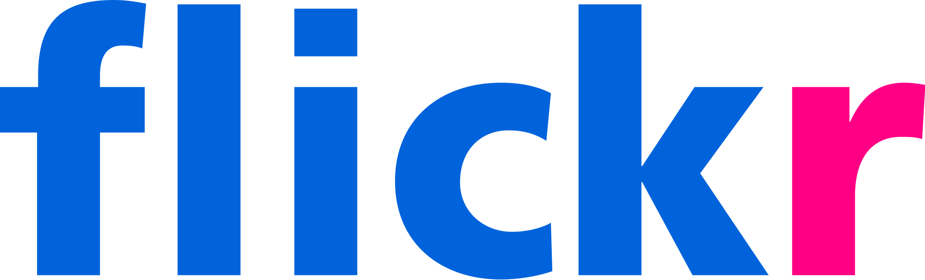

Software Cycles Have Been Getting Faster
Continuous Delivery & DevOps Drive Shorter Software Cycles
Install Mindset
Infrequent (Manual) Deployments
Risk
(2009)
10 Deploys/Day
Cloud
Native
Practices
Time
Service Mindset
100 Deploys/Day
(2013)
Risk
Continuous (Automated) Delivery
Time
Sources:
1) How Netflix Deploys Code, InfoQ
2) Continuous Delivery + DevOps, Nicole Forsgren, Agile India, 2016
Notes:
SOFTWARE CYCLES HAVE BEEN GETTING FASTER
Focus on Speed is an Accelerating Trend
The focus on speed is not a new one. This trend started a while back, notably with the software driven, consumer facing Internet companies. Whereas the trend in 2005 may have been to update websites every quarter, since then, we’ve seen a flurry of companies that have found that becoming and remaining customer focused is critical to competitive differentiation, commercial success and downright survival. Given that user were consuming their website as services (as opposed to installing their software), it became critical for these firms to add, change and update their sites more frequently than had been required before, in order to experiment and learn from customer behavior, optimize user experience and keep customers engaged and returning to drive profits. Automation played a key role in making this possible and is continuing to see greater adoption and play a larger role (more on this later).
This trend of focusing on speed of software delivery has been accelerating over time. We have gone from mostly manual, infrequent deployments to faster and faster deployments, and well on our way to eventually driving continuous, automated delivery of software. A couple of data points along this spectrum can shed some light on the nature of this accelerating trend. For example whereas Flickr was a pioneer in driving speed of delivery in 2009 with 10 deploys a day, by 2013, Netflix was leading this trend with almost 100 deploys per day.
Speed Requires a Shift in Mindset
In order to focus on software delivery speed, many of these enterprises had to undergo a shift in mindset and priority. They had to make the leap from thinking about their deployments as infrequently updated via big-bang “installs” to “services” that should undergo frequent, small, incremental changes in place (without downtime). As a result, the approach to software development and delivery – both the processes and architectural approaches - had to fundamentally change to support this shift to a service-oriented operational priority. New practices/approaches emerged to enable this shift to a service mindset including DevOps, Continuous Delivery and Microservices.
We call them cloud native practices as they support a service mindset, and cloud, with its elastic scale for handling fluctuating service loads, is the ideal platform for services.
Historically, an install mindset and waterfall software methodology had made sense for software since most of it was installed and maintained on premise by (primarily enterprise) customers. Customers got a few updates every so often and were primarily enterprise customers who had expertise and resources to install and maintain software. That install mindset initially carried over into early web sites. As a result, there had been a couple of (circularly dependent) reasons to do infrequent big-bang deployments/installs: 1) similar to enterprise installs, the deployment process was manual and time consuming (and therefore an expense to be minimized) and generally involved downtime 2) the deployment process was fraught with risk because of manual deployments and the large number of changes that accumulated (ironically, because of the infrequent deployments) and hence the deployments should be (further) minimized (to minimize potential disruptions in service). This led to a situation where each website update (“deployment”) became a significant anxiety filled event that carried tremendous risk.
However, increasingly, new Internet businesses required direct engagement with customers (who were consuming a service/experience and not installing software), which fostered a new service-oriented mindset to meet consumer requirements, e.g. no downtime, frequent updates, etc. The key shift that occurred that enabled the new mindset to take hold involved the aggressive use of deployment automation in order to reduce deployment time relative to development time (in order to meet the business goal of driving frequent updates). Otherwise, even if new features were developed quickly, they would take a long time to get in front of customers using manual IT processes. In turn, increased automation and lowered cost of deployment led to routinely supporting deploys that encapsulated fewer and fewer code changes – a stark contrast to just a few years before when the priority had been to bundle as many changes as possible since the release process was an expensive, time consuming, risky, manual process. Ironically, more frequent deployments led to lower deployment risk as smaller number of code changes had a reduced potential to create problems and were exponentially easier to test and validate. As a result – contrary to conventional wisdom at the time - deployments not only got faster, but more reliable. This is what a service oriented business needed.
This enabled companies to finally break through the circular dependency that had limited their delivery speed and business agility. A new set of practices emerged to support this shift in mindset that were designed to optimize the key metric: time to value. New cloud native practices such as DevOps, Continuous Delivery and Microservices emerged that enabled this shift to short software cycles and rapid delivery.
Mainstream Adoption
With the increasing global internet penetration and mobile adoption, there is a need to directly engage with consumers and an increased focus on digital transformation, similar to the early Internet leaders. However, software practices at most traditional enterprises are not set up to prioritize time to value and speed of software delivery. Thus, establishing “time to value” as a priority and developing the relevant capabilities is quickly becoming the differentiator between yesterday’s enterprise leaders, and tomorrow’s enterprise leaders. Thus, in another example of the ongoing Consumerization of IT, these cloud native trends are seeing mainstream adoption by the largest enterprises to rejuvenate their software practices.

Slide 9

Delays in Enterprise Software Cycles
BUILD
FAST
RELIABY
DELIVER
Build From
Scratch
Monoliths
Time to Value → 0
Provisioning
Delays
Build
Overhead
Development
How do you Develop?
How do you Test?
How do you Deploy?
Production
Errors
Complex
Deployment
Deliver
Manual
Testing
Slow & Complex
Release
Slow
Debugging
Notes:
DELAYS IN ENTERPRISE SOFTWRE CYCLES
Enterprise Challenges
As enterprises are beginning to aspire to faster development cycles, it’s important to understand that the time to value for an enterprise is dependent on its software development methodologies and processes. How streamlined they are and how seamless they are eventually determine how quickly software can be built and delivered to customers. Enterprises should look closely at their current software practices and ask:
How do you develop software? For example, what architectural patterns are used, are productivity and resilience boosting language frameworks used, are developer services used or is everything built from scratch, etc.
How do you test software? For example, is testing an afterthought after development (a la waterfal methodologies) or part of the development process, is testing automated, is testing repeatable, etc.
How do you deploy software? For example, how quickly can you provision and configure infrastructure, is the process automated and repeatable, etc.
The Software Cycle: Build & Deliver
Broadly, the software cycle consists of 2 activities:
Build – Developers design and code the application or modules according to requirements. Developers provision local or personal environments to deploy and (locally) test their code they are working on.
Deliver – Delivery of code comprises all the activities that happen to convert source code into a production deployment, e.g. integration testing, debugging, infrastructure provisioning and configuration, deployment, rollback/recovery, etc. Eventually, software is deployed to the live production environment such that customers can access it.
Although developers focus on writing code, their advice, input and involvement is required for delivery as well. Thus, developers generally spend all their time in this build-deliver cycle. A high performing software business aspires to go around this cycle as fast as possible. Going around this cycle as fast as possible ensures that new functionality is being developed that is market facing and strategic and allows the business to learn rapidly from the customer/market.
However, traditional enterprise software practices today face numerous sources of delay and friction at each step of the build and deliver cycle, which is what makes it difficult for them to deliver software quickly. For example, many still use some version of a waterfall approach to building software, which has a sequential approach to developing large chunks of software (e.g., requirements gathering, design, develop, test, etc.). Even for organizations adopting some agile methodology and focusing on developing smaller bits of functionality, other aspects of software process and architecture makes it hard to develop high quality software quickly.
Thus, various sources of friction create unnecessary and undesirable complexity, and make the software development process long, slow, complex, manual, error prone and brittle. Let’s look at some of these sources of friction before looking at how modern approaches address them.
BUILD
Provisioning Delays – Rapid prototyping to try new ideas requires fast and easy provisioning of disposable deployment environments by developers. Waiting for Ops to provision and config dev/qa/prod environments creates significant delays. The alternative is for developers to self provision, e.g. use Docker for dev, which does not carry over to production easily (such as no central control of security patches) or use a credit card on AWS with all the associated problems of Shadow IT (e.g. no control on spend, compliance, etc.). Even then, developers are still stuck spending time on unproductive configuration and administrative tasks, once they have provisioned raw infrastructure resources.
Build from Scratch – Much of the functionality required to implement business logic has been abstracted and made available as reusable frameworks and components (e.g. spring). As new classes of problems are identified (e.g. leader election in distributed systems), new frameworks are developed or existing ones are extended. Not all developers are aware of or use the latest frameworks, resorting many times to reinventing the wheel (“building from scratch”) and trying to solve complex problems that are hard to get right and have already been solved. A rigorous and consistent use of frameworks (esp. OSS) can accelerate development cycles by enabling developers to use highly tested software built by pooling the best ideas from a community of advanced practitioners. As a result, enterprise developers can focus on building differentiating business logic, without the distraction of “building from scratch” and in the process produce less code that needs less test coverage (i.e. less chance of bugs in production). Another way in which this problem of redundancy manifests is monoliths (see below) that limit reusability, thereby promoting similar functionality to be implemented across multiple projects.
Monoliths – A lot of applications are comprised of large, complex code bases with co-mingled concerns and significant (yet unclear) interdependencies that are hard to untangle. As a result, code becomes complex, making it difficult for new developers to quickly understand and become productive as well as making it difficult to debug and reuse. Furthermore, different developers/teams not only have to develop their own functionality but also worry about not breaking others’ dependencies and assumptions thereby making the code fragile (small changes easily introduce bugs) and getting in each others’ way (requiring greater cross-team synchronization). The complexity thus not only requires greater testing (because multiple concerns are co-mingled in the same code base) but also forces the teams to move at the pace of the slowest developer/team during the release cycle because of the tight inter-dependencies.
Overhead Development – Many times developers end up having to spend time to develop software that does not add business functionality. This can take various forms
Writing code for APIs to collect real-time analytics or perform rate limiting.
Non-functional code for operational management such as code to monitor and restart services that go down or writing and managing logs
Tooling integration and automation such as aggregating and analyzing metrics, automating testing, etc.
Reading configuration files for service discovery; systems to hot deploy configuration changes
Code to handle failure, scaling and high availability
Code to handle other complexities of distributed computing
DELIVER
Manual Testing – Beyond unit tests, few tests are automated requiring significant manual effort to perform repetitively for incremental releases in order to test even small changes. Even when automation is used (e.g. Jenkins), there is a significant level of effort required to either build custom automation or to keep the 3rd party (e.g. Jenkins) services running.
Complex Deployments – Meaningful testing for modern, distributed applications requires a complex deployment and configuration. A lot of testing environments are set up and maintained manually by QA teams, forcing either lots of changes to be aggregated to justify the manual effort to set up for the test, or taking significant time to set up for each test for incremental functionality (driving up costs). There is no comprehensive, automated means to provision and configure container based test environments that can be replicated on demand to enable not just iterative testing, but also allow allow role based access, e.g. individual developers can set up an environment to run a particular complex test. Thus, developers have to wait for special QA teams who have access to test environments to set up, configure and potentially conduct the tests. This scenario creates an incentive to aggregate functionality into releases, rather than to release functionality incrementally. In addition, it creates a manual workflow, where an automated workflow would be much faster.
Slow Debugging – Organizational silos, lack of Dev, QA and Production parity and configuration drift in production make it hard to track down problems while deploying code to production. As a result, significant effort is required for synchronization between teams, and many times leads to lots of inter-team friction and finger pointing between dev and ops. This further slows down the ability of an organization to release functionality quickly. This problem is further exacerbated by lack of consistent (or any) tooling for distributed apps in dev and production deploys, e.g. tracing, metrics, log analytics, etc.
Slow & Complex Release – The use of custom toolchains and scripts leads to ad hoc combinations of automation and manual configuration that results in “snowflakes” – unique release processes for each app per environment (test/qa/prod). The sheer complexity of a production deployment results in a highly involved, slow and manual process where developers can get pulled in ad hoc to debug and solve problems. For example, sometimes people make mistakes in manual configurations, e.g. linking to different versions of a library for different modules. Or not knowing or using the configuration settings that were used in development environments. In order to avoid the overhead of these slow processes, teams try to bundle features and minimize releases, thereby slowing software delivery by doing fewer releases over a long period of time.
Production Errors - Errors in production (after code is live in production) due to human error, dev-prod parity issues, or code bugs are hard and time consuming to replicate in dev environments, which slows down availability of working functionality and is an unproductive use of developer time that should be spent on building new functionality.
AppDev/Developer Productivity Suffers
With all these sources of friction, software organizations face many hurdles in trying to go fast. They are navigating a complex process that has little to do with solving business problems, and more to do with being the “integration glue” between disparate tools, teams and processes that make the software release process high risk, slow and brittle, with many sources of potential unanticipated delays.
The way many teams solve the problem of risk and developer overhead is to further slow things down and minimize the number of times developers need to be involved, is by releasing infrequently and bundling software into large releases (presumably to help them spend more time coding). This only amplifies the problem. Fewer releases lead to large releases of monolithic code which requires greater test coverage due to unstructured dependencies and higher code complexity. This implies a greater risk of some failure in production. This is the opposite of the goal that AppDev needs to pursue: SPEED & RELIABILITY.
The result is that enterprises think their releases are more reliable, but actually they are just slower in releasing new functionality to the market, and have a higher risk of failure for each release due to bundled up changes.
NOT ONLY ARE ENTERPRISES GOING SLOW, THEY ARE DOING SO WITH HIGHER RISK!!!
Your goal should be the opposite: release software frequently in small chunks that individually carry low risk. This increases your speed to market and also reduces your risk for each release. Any problems can be easily detected and reversed. If there are problems with smaller releases, you can identify them faster because the changes are small and there is temporal proximity: the developer did not make the changes months ago…he or she probably made the changes in the past few days or weeks and still remembers the code to be able to fix it quickly.
So, how do you do this?
-------------
Check on types of testing to see if manual testing point is valid
Do we mention friction due to change review boards?

Slide 10
Software Practices Are Evolving
Lack of Collaboration
Manual Testing & Release
Monolithic Architecture
“Not my problem”
Separate tools, varied incentives, opaque process
Release once every 6 months
More Bugs in production
Tightly coupled components
Slow deployment cycles waiting on integrated tests teams
Then
DevOps
Continuous Delivery
Microservices
Shared responsibility
Common incentives, tools, process and culture
Automate Tests, Release early and often
Higher Quality of Code
Loosely coupled components
Automated deploy without waiting on individual components
Now
Cloud Native
Notes:
SOFTWARE PRACTICES ARE EVOLVING
Root Causes of Delay
Many of these delays are symptoms of just a handful of underlying causes of delay. In addition, these causes are cross cutting – they affect more than one element of the build-test-deploy cycle, e.g. a monolithic architecture not only slows down development, but also testing and release. Let’s inspect these causes.
Lack of Collaboration : Development teams are incentivized to develop new features as fast as possible (go fast). On the contrary, IT Ops is incentivized to ensure stability and security. This has traditionally implied that changes to production deployments should be minimized and software should be updated, and deployed infrequently (go slow). Different goals for these teams lead to “principled opposition of objectives” that result in unique environments and tooling for each team geared for their individual goals. A lack of parity between development and qa/production deployment environments (“dev/prod parity”) is a natural and inevitable outcome of such a scenario yielding significant synchronization/communication overhead as software moves from development to QA and production deployment. Thus, organizational differences, incentive misalignment and technical chasm between the Dev and Ops teams leads to practices that engender and reinforce differences between them, making it difficult to collaborate in order to move fast.
“Snowflakes” (Manual Testing & Release and Inconsistent/Missing Automation): Many of the processes used by developers can not only be automated, but also shared with IT Ops to create process consistency across teams and environments, e.g. automated tests, environment provisioning and configuring, code build and deployment. Unfortunately, today many are done manually in enterprises, or have partial automation with other portions done manually or with custom scripting. (For example, development teams may use Jenkins as their CI server and Chef for deployment and configuration, but still have to bridge the gap between Jenkins and Chef (e.g. copying files to a staging area) via manual or custom scripted workflows to build a deployment pipeline.) Traditionally, these processes/workflows have been inconsistent between teams, projects and even environments (e.g. dev vs. prod), thereby introducing delays due to handoff and communication/synchronization overhead as code moves from dev to production. Ad hoc combinations of automation and manual build, test, deploy workflows yield unique processes (“snowflakes”). Unique IT processes for each application from different teams require manual oversight by IT operations which yields, slow, complex, error prone and brittle IT workflows with significant “administrative overhead” and high chances of deployment errors.
Monolithic Architectures: Monolithic software architectures tend to promote tight software coupling (interdependency) of software modules that could (and should) be independent. This yields higher development and testing complexity, and limited reusability - both enemies of speed. Furthermore, monolithic architectures inevitably lead to different modules/dev teams inadvertently restricting each others’ technology choices, development cadence, roadmap evolution, etc. resulting in increased inter-dependence, higher synchronization overhead and higher complexity/delays in build, test and delivery. This results in “weakest link” scenarios where you can only move as fast as the slowest team. And, the only way to minimize lots of such potential “weakest link” delays is to reduce the number of releases and bundle software into infrequent, large, risky releases with lots of changes. However, as discussed earlier, large releases take more time, and thus, software is delayed getting to production. You end up with a few releases with massive changes (where the potential for something to break is higher), rather than small (low risk) changes happening on an ongoing basis to different parts of the application or website.
Shifting Practices
As enterprises focused on getting to market faster over the last 10 years, new software practices have evolved that target and eliminate these root sources of delays to help accelerate the software cycle. Let’s look at these closely.
DevOps – DevOps is a software practice that flips the traditional development and IT Ops dichotomy on its head, and instead espouses that the two teams work closely together as tight collaboration is needed to get software to production in a services world with high velocity of change. It emphasizes collaboration, communication and common culture/processes between historically silo’d developers and IT ops teams. Historically, this collaboration has been an area of organizational friction. Given that the IT Ops team is tasked with packaging and deploying software developed by the Development Team, collaboration and transfer of knowledge between these teams is critical to avoiding miscommunication and delays and to ensuring smooth release processes. This is even more critical in a continuous delivery context where new functionality continually moves between the dev and IT ops teams. Automation and shared tooling (e.g. CD pipeline) can promote common processes and a common understanding of the entire software delivery process, and hence minimize friction and promote collaboration. However tools/automation alone are of limited utility unless a culture of joint responsibility is adopted.
Continuous Delivery (CD) – Complementing the Microservices architectural approach that supports “incremental yet rapid” innovation, Continuous Delivery (CD) is a “process philosophy” of rapidly developing and testing small sets of software functionality such that the time gap between successive sets of new functionality that is ready for deployment, is minimized, i.e. software is being “continuously delivered.” (Note, a delivered feature does not necessarily imply that it is deployed in a live production environment – only that it has been validated and ready for deployment if the business chooses to do so.). The goal of continuous delivery is to test and validate software via environments that are progressively identical to a production environment such that by the end they can be marked as “delivered” with high confidence, i.e. ready for production use. CD relies on the notion of Continuous Integration - CI (i.e. daily code submission, build integration and testing) and automated CD pipelines to achieve this goal. Thus, automation is central to CD. CD pipelines accelerate software delivery by automating the movement of code from source repository through testing and validation in progressively more production-like environments (e.g. dev unit test, integration, qa) to final deployment to production. These automated pipelines provide speed and consistency, and can be the means of collaboration for multiple teams, e.g. dev, QA, ops.
Microservices – Microservices are an architectural approach that emphasizes decoupling complex functionality into smaller, independent (micro)services that consist of simpler functionality with fewer, focused concerns. These microservices run separately and can only be accessed via well defined interfaces that hide the implementation details thereby promoting loose coupling. The key value that Microservices provide is independence; they can be developed and operated by independent teams. An application is delivered as a collection of (distributed) microservices that interact with each other through well defined (and slow evolving) interfaces. As a result, as long as it maintains a stable interface contract, each microservice can make independent choices on technology, roadmap and development/release cadence. The independence enhances resilience (e.g., if one microservice is unavailable, other functionality can still be accessible) and eliminates synchronization overhead between teams and software modules. Thus, microservices enable parallelization of development and operations as well as rapid and incremental innovation, thereby significantly enhancing speed to market. Microservices make it possible to selectively and elastically scale the parts of the application seeing demand, and are truly a cloud native design pattern. Also, Microservices, with their focus on small, bounded concerns, make it easier to handle evolutionary application complexity; they enable evolving an application to add features and/or cross domain boundaries, e.g. a car insurance carrier, can cross over into home insurance. Netflix is a good example of a microservices architectural approach.
It is important to remember that microservices make sense once you have reached a “critical mass” of understanding the domain of the application – the key entities, constructs, actors and their interactions that will comprise the core of the application functionality/value proposition. This is generally true in well defined use cases, e.g. stock trading. Most PCF customers that are existing, stable and/or large enterprises will know their business well enough and fall in this category, unless they are trying something new…
When innovating and building a new application that straddles domains, a monolithic approach makes sense early on as you are exploring the cognitive space of the domain of the application and defining a new use case. In this scenario, monoliths can help you move quickly without having to refactor microservices and their interfaces continuously. As the application matures, and you have a good handle on the different constructs, entities, actors, etc., it is critical to refactor using a microservices approach in order to gain many of the benefits (mentioned earlier) for the long term. (Note, microservices make sense for complex enterprise apps. If the app is limited in use case, and never grows beyond a certain level of complexity, then also microservices may not make sense – they will be overkill).
Finally, it is also important to remember, that after refactoring, the application architecture will not remain static. As the application evolves, it will continually need to be refactored, many times resulting in one microservice being broken apart into multiple, fine-grained services.
Cloud Native
Collectively, we refer to these new practices as Cloud Native practices as they are uniquely designed to enable building and delivering modern, cloud software that rapidly and incrementally evolves, can scale horizontally and has resilience by design. These three practices together address the weaknesses in earlier approaches
Monolithic Architecture → Break up Complexity
Lack of Collaboration → A culture of joint goals and responsibility, and shared automation (see below) for common processes (e.g. provisioning and deployment) can alleviate much of the friction. Rationalize tools that facilitate collaboration, common processes and let both parties go fast.
Manual Testing & Release → Rationalize, standardize, automate and integrate as many processes as possible.

Slide 11
Cloud Native Drives Complexity
DevOps
Continuous
Delivery
Microservices
Multiple Stakeholders
Many Moving Parts
Rapid Pace
Development & Operational Complexity
Notes:
CLOUD NATIVE DRIVES COMPLEXITY
Speed in development and delivery is essential for the next generation of always-on, software services that reside in the cloud. Building Cloud Native software using DevOps, Microservices and Continuous Delivery makes sense as they are designed for speed. They represent a new way of developing software – a new set of practices. These techniques fundamentally change our notion of developing software: speed, automation and continuous incremental evolution changes how software has been done historically as big bang, manual deployments and upgrades.
Demands Placed by Cloud Native Practices
Ideally you want to adopt these practices together, since they are interdependent and synergistic. But adopting these practices means other support is necessary – you cannot do things the old way.
Why? Because, what happens when you embrace these techniques simultaneously? You end up significantly increasing development and operations complexity by combining multiple stakeholders (DevOps) who are rapidly delivering software (Continuous Delivery) comprised of many small components and moving parts (Microservices).
Dev Overhead: Adopting these practices yields very high complexity and overhead – for example, you need to be able to continually create, configure and destroy dev/test environments on demand to support the continuous integration and testing required for continuous delivery. You need to be able to build microservices easily so that your developers can focus on business logic, and not get lost in the complexities of enterprise computing such as service discovery, service configuration, high availability, security, distributed computing, etc..
Ops Overhead: Dev is only the half of it. How do you manage everything on Day 2, once code is deployed in production? How do you handle failure, recovery, scaling, upgrades, security, patching, monitoring and other operational issues when you are no longer managing 5 apps, but 25 microservices instead? It’s a lot of work to handle manually, without automation. If not handled in a structured and automated manner, it can become a source of chaos and delay.
So, it seems like we we have a set of practices that are hard to implement without some support.

Slide 12

Cloud-Native Technology
Software Practices – Technology Synergy
Cloud-Native
Software
Technology
Technologies Enable the State of the Art
Cloud-Native
Practices Embody the State of the Art
Software
Practice
Notes:
CLOUD NATIVE TECHNOLOGY
Software Practice-Technology Synergy
Throughout the history of software, new practices have emerged that define how to build more complex software easily. And new practices have always been accompanied with new technologies that support these practices by making them easier to adopt and implement. For example, when assembly programming gave way to high level languages for building more complex applicaitons, compilers were developed to generate the machine instructions. When the PC arrived, language frameworks were developed to simplify implementing more complex graphical user interfaces. More recently, the app server emerged with the need to manage the enhanced needs of web applications beyond those of a web server. Thus, there is a synergistic relationship between software practice and software technology.
And, this new set of practices for the cloud design point is no different. As we have seen, these new Cloud Native practices (DevOps, Microservices, Continuous Delivery) are difficult to adopt by themselves. We believe that they need to be supported by new technologies that automate and simplify these practices.
Supporting technologies make it easy to follow these practices and have guardrails in place to prevent problems and keep people on the right track. The technologies ensure reliability and safety for dev and ops while moving fast. Thus, Practices and Technologies have a synergistic relationship. The technologies support the practices, the practices leverage the technologies.

Slide 13
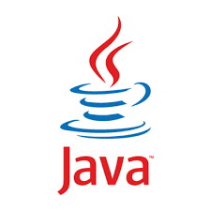



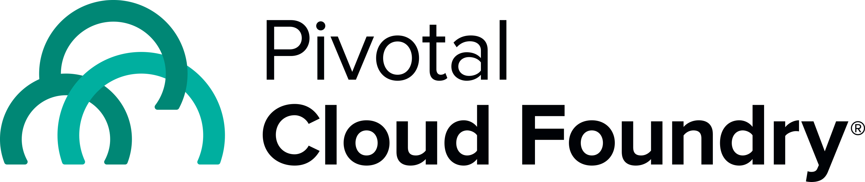

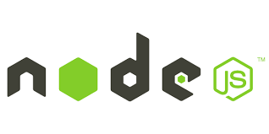
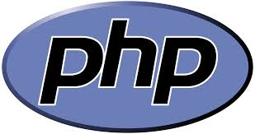
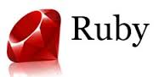
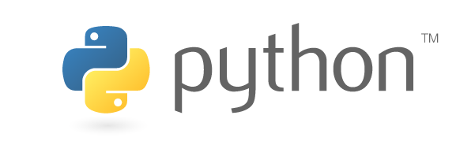
Cloud Native Technologies
New & Existing Workloads
Market Trends
Build Fast
Framework Support for Accelerated Development
DevOps
Continuous
Delivery
Microservices
Deliver Reliably
Platform Support for Streamlined Developer and Ops Workflows
Notes:
CLOUD NATIVE TECHNOLOGIES
Pivotal - Transforming Trends Into Technologies
Pivotal is at the forefront of developing technologies to support adopting cloud native practices such as Microservices, Continuous Delivery and DevOps to help you BUILD and DELIVER software quickly and reliably. Together these technologies enable enterprises to rapidly build software and to operate it reliably. The key elements of these technologies include:
Native support for dominant enterprise application development technologies such as Java and .Net (other languages are supported as well). Additional framework support for microservices development with Java and .Net bindings to Spring Cloud Services. Pivotal is also the steward and primary contributor for Java Spring (leading Java enterprise application framework) and Spring Boot.
Support for Continuous Delivery and Devops through PCF
More generally, Pivotal is investing in developing these technologies to go beyond supporting particular practices and to focus on the cloud native philosophy: to accelerate and simplify the development and operation of cloud workloads in general. Thus, Pivotal continues to invest in enhancing and accelerating the modern software development cycle. Furthermore, Pivotal is committed to meeting enterprises where they are with support to help develop and operate both next generation and legacy workloads rapidly, efficiently and cost effectively.
We are building technologies that help you focus on building your software and innovating your business rather than focus on complex infrastructure concerns.
Pivotal Cloud Foundry
Origin: Cloud Foundry is an open source application platform originally started in 2009, at VMware. Pivotal inherited the project. Since then, the Cloud Foundry Foundation has taken up stewardship of the open source project, although Pivotal remains the lead contributor. Cloud Foundry has garnered wide industry support through the CF Foundation, comprised of over 50 companies, including Docker, HP, IBM, SAP, Pivotal, Vmware, EMC, Cisco, Accenture, GE, JP Morgan Chase. Pivotal offers a commercial version of Cloud Foundry known as Pivotal Cloud Foundry.
Description: Pivotal Cloud Foundry (PCF) is an open source based cloud platform purpose built to accelerate software delivery. It is the next-generation application platform for continuous delivery, cloud scalability and resiliency. PCF provides a unified DevOps platform intended to address the challenges that both Developers and IT Operations teams face. For developers, it facilitates the cloud native practices that enhance dev productivity and allows them to iterate rapidly and safely. PCF also supports Ops teams to handle the operational ramifications of cloud native practices (e.g. elastic scale, zero downtime, frequent updates, etc.), and facilitates the automation, consistency and speed necessary for cloud native software operational excellence. As a unified platform that promotes common concepts, practices and tools (e.g. buildpacks, cf push, cf scale), PCF also promotes easy collaboration between Dev and Ops to enable a fluid DevOps practice. Thus, PCF yields the development speed and operational excellence critical for modern enterprises to remain competitive in the face of global competition.

Slide 14
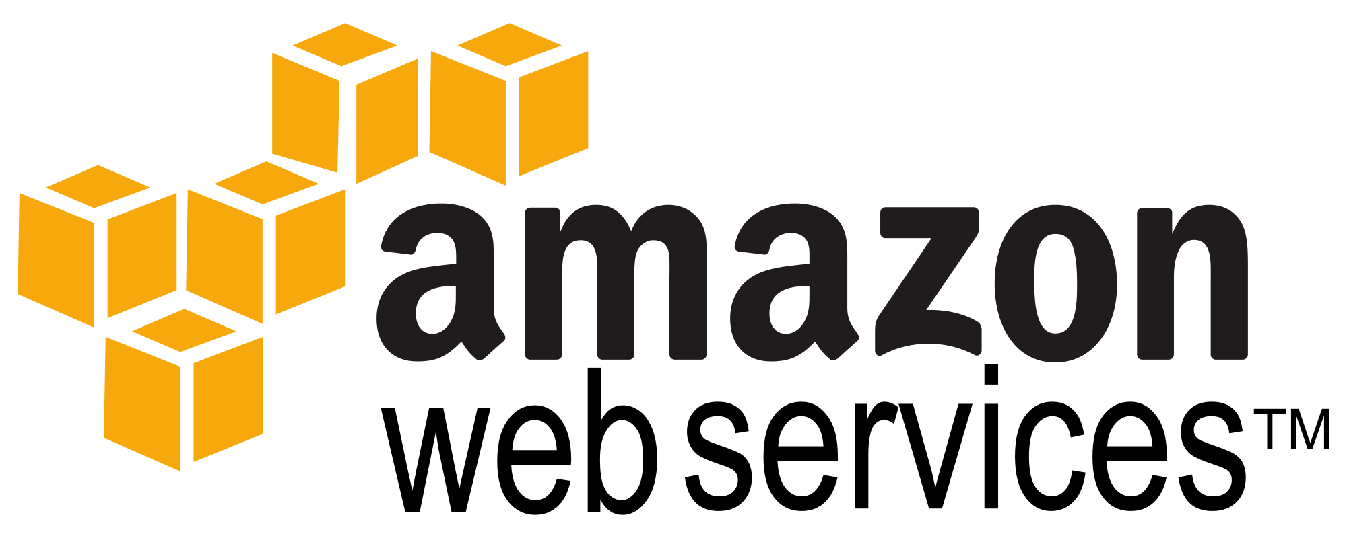
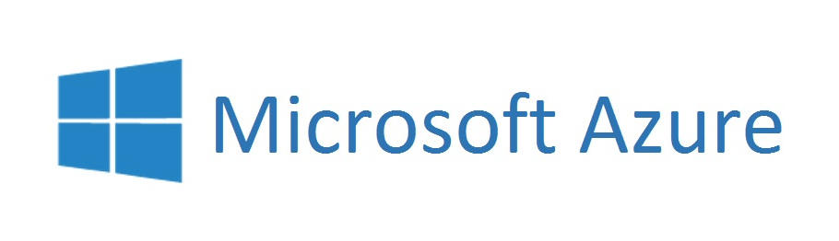
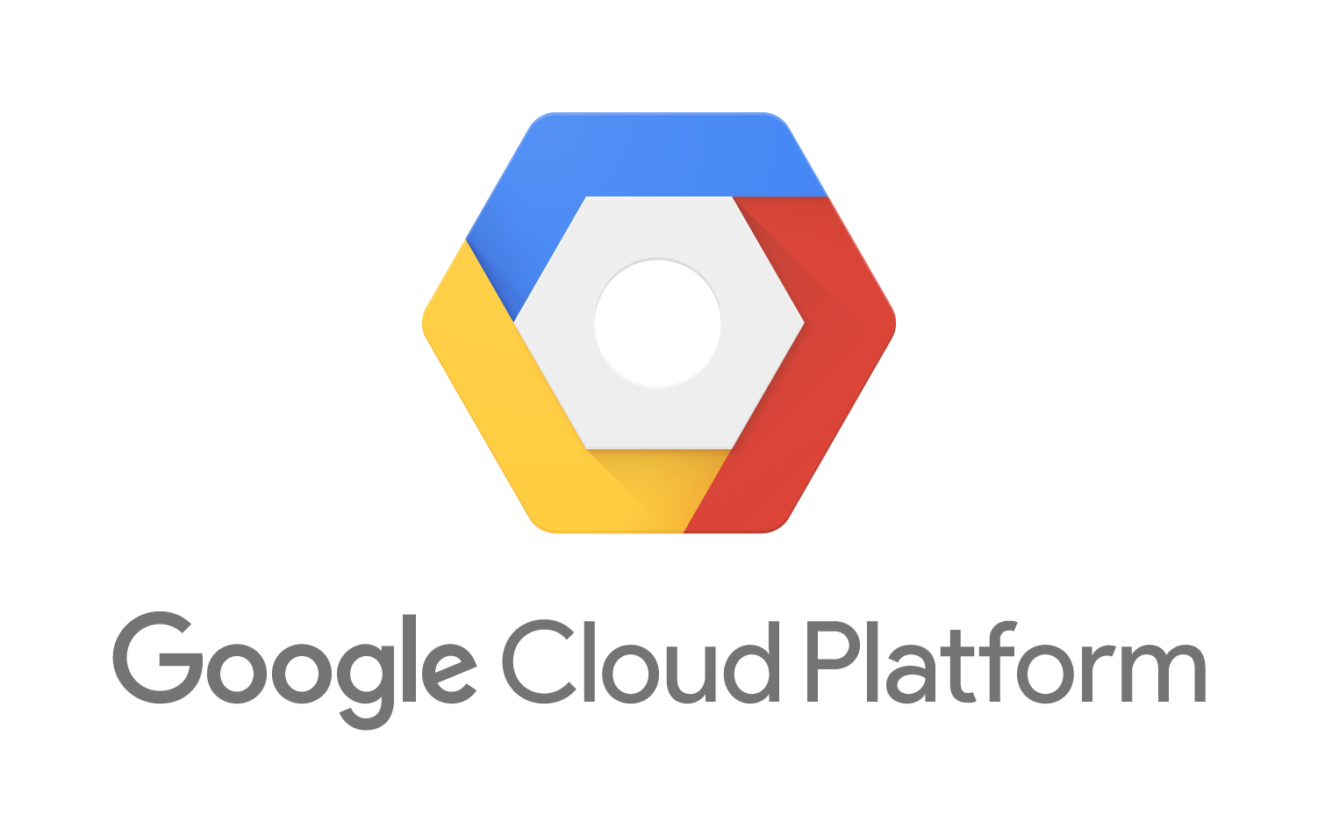


Enterprise Application Portfolio
Replatform
Modernize
Migrate
Cloud Native
ROI Funds Transformation
Existing Workloads
New Initiatives
$$$$
Replatform
Modernize
Migrate
Cloud Native
Runs on PCF
Built for PCF
…
Auto-scaling
High Availability
Logging/Metrics
Security
Zero Downtime Updates
Notes:
ENTERPRISE APPLICATION PORTFOLIO
Heterogeneous Application Portfolio
Although Cloud Native Apps are the future, most modern enterprises consist of a heterogeneous mix of workloads. Whether due to acquisitions, or multiple initiatives started at different times and at different levels of maturity, enterprise workloads span the gamut of application architecture and technology stacks. At Pivotal, we recognize that customers must manage a set of workloads that range from brownfield to greenfield. Pivotal can help, not only with new cloud native application initiatives but also existing workloads that can be replatformed/modernized or migrated to Pivotal Cloud Foundry.
Savings from Operating Existing Workloads on PCF
Replatforming or migrating application workloads to PCF will allow enterprises to immediately realize operational savings from built in capabilities that have in the past required significant effort to accomplish, e.g., high availability, security, scaling, aggregated logs, etc. These capabilities will not only provide immediate speedup and reliability to those workloads, but also immediate relief to IT staff desperately trying to keep up with the business’ velocity of change. Additional, the migration can help reduce proprietary license spend. And, all these benefits are available on the cloud of your choice, and robust integration with enterprise IT infrastructure, such as identity management from various vendors. Over time, enterprises can begin to incrementally modernize these workloads by selecting subset of functionality that can, for example, be refactored into a microservice using the strangler pattern.
Greenfield Initiatives
Many times, it can be hard to justify and pursue new greenfield initiatives using modern technologies when you are already struggling to meet requirements of existing workloads with current budget allocations. With the ROI from moving existing workloads to PCF, Application Development organizations can find the savings to drive new initiatives to build modern apps, e.g. A 12-factor app developed with distributed, API and microservice architectures that includes backing data services, and runs on PCF with full metrics and monitoring, CI/CD pipeline, elastic scale, HA, etc..
Built using Cloud Native practices, such an app would not only accrue to business value, but also help the organization to learn new skills and take advantage of new practices.
Thus, Pivotal Cloud Foundry provides the single platform that can help you run both legacy as well as modern workloads side-by-side.
Takeaway: A large part of enterprise portfolio an run on PCF

Slide 15

BUILD Fast
Notes:
Let’s look at how Pivotal can help you build code rapidly
Later we will discuss how Pivotal can help you test, deploy and manage applications quickly and reliably.

Slide 16
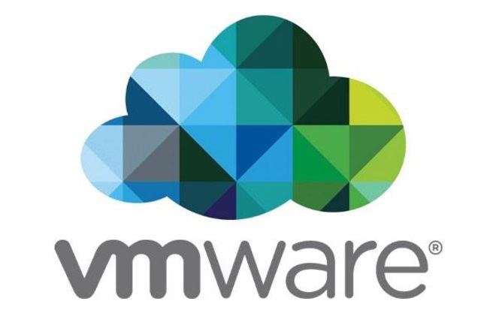

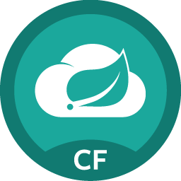
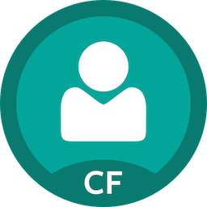
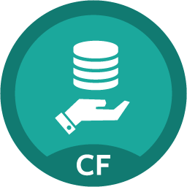

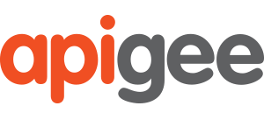
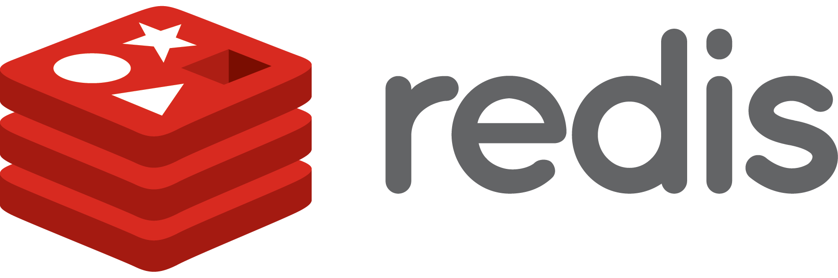

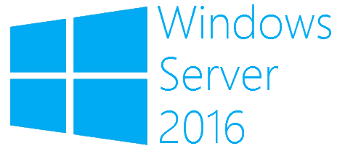
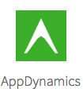
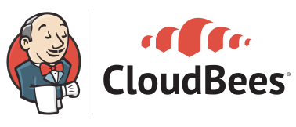
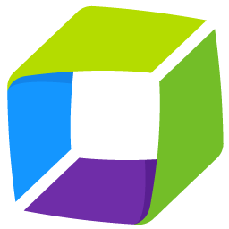
How Pivotal Can Help
Developer Choice
Developer Support
Languages
Clouds
Pivotal Tracker
Metrics, AppDynamics, Dynatrace, New Relic
Language Frameworks & Application Services
Project
Management
Optimize
Code
Apps Manager, CLI, REST APIs, Ops Manager
Language Buildpacks for Staging & Packaging
Manage
Build
Platform Services
OSes
Spring Cloud
Services
Single Sign On
MySQL
Deploy
Provision
Test
API Driven Platform, Concourse, Jenkins
Self-Service and Role-Based Access Control
Dynatrace
AppMon
Container SSH, Loggregator, Metrics
Notes:
HOW PIVOTAL CAN HELP
Before we look specifically at building code, it’s helpful to get a big picture view of all that Pivotal has to offer that can help you be effective in quickly building and delivering applications.
Developer Choice
Pivotal Cloud Foundry provides developers extreme choice in technologies that they choose to leverage in building their applications.
Languages: PCF offers build/deploy automation for many languages including, Java, .Net, PHP, Ruby, Python, node.js and Go. In addition, it is extensible, and can support automated build/package/deploy for other languages, runtimes and frameworks via buildpacks.
Clouds: PCF allows flexibility to run your applications on any cloud infrastructure, whether on-premise (vSphere, Openstack) or with major public cloud vendors (AWS, Azure, Google Cloud Platform). PCF also provides the extensibility to support new and future underlying infrastructures through the Cloud Provider Interface, an infrastructure API layer implemented by the cloud infrastructure provider.
Platform Services: Pivotal has a large and growing collection of developer services that developers can use to build applications rapidly. Services are available from Pivotal as well as its ISV partners. In addition, Pivotal also provides a means to access the large services ecosystems of the major public cloud providers. Finally, Pivotal services ecosystem continues to grow and provide a consistent developer experience thanks to the standardized Cloud Foundry Service Broker abstraction.
OS: Many enterprises currently support mixed linux/windows based workloads. Pivotal Cloud Foundry allows enterprises to run both types of workloads natively on its elastic runtime.
Developer Support
In addition to provide tremendous developer flexibility and choice around key technologies, Pivotal also automates and supports the full spectrum of activities during a software lifecycle.
Project Management: Pivotal provides Pivotal Tracker, the popular agile project management tool, with built in analytics for delivery planning and prediction, and story linking, user feedback and 3rd party integrations, (github, slack, zendesk) to maximize productivity and drive a virtuous feedback loop.
Coding – Pivotal provides the leading application framework (Spring) for Java developers along with .Net/Java access to Spring Cloud Services as well as other highly available developer services for rapid and high quality code development.
Build – Buildpacks provide automation for build, stage, package and deploy workflows in enterprise contexts, that enable not just deployment speed but also deployment consistency and a simplified user experience.
Provision – PCF’s built in quota allocation and provisioning framework allows for efficient self-service access that enables developers to become productive in minutes rather than months when trying to get access to configured compute capacity.
Test – PCF incorporates various tools for debugging and monitoring that can accelerate development by facilitating rapid build-test. Some capabilities that support this include aggregated logs (loggregator). Container SSH to connect securely to a running container, Metrics to monitor application behavior to known test inputs, etc.
Deploy – PCF provides Concourse, a built in CI/CD tool as well as support for Jenkins. Being an API driven platform, these tools can easily use the APIs to orchestrate a CD pipeline to automate testing and deployment.
Manage – PCF provides various means of managing both the platform as well as users and running applications. The platform can be managed by directly calling APIs, or using the CLI or Apps Manager UI (which uses the API) to scale applications, inspect runtime environment configurations and status, etc. In addition, the platform provides Ops Manager to manage the the infrastructure and PCF deployment (using Bosh under the covers).
Optimize – PCF enables metrics gathering and monitoring to enable developers to analyze application behavior in order to fix problems or enhance performance.
Security

Slide 17
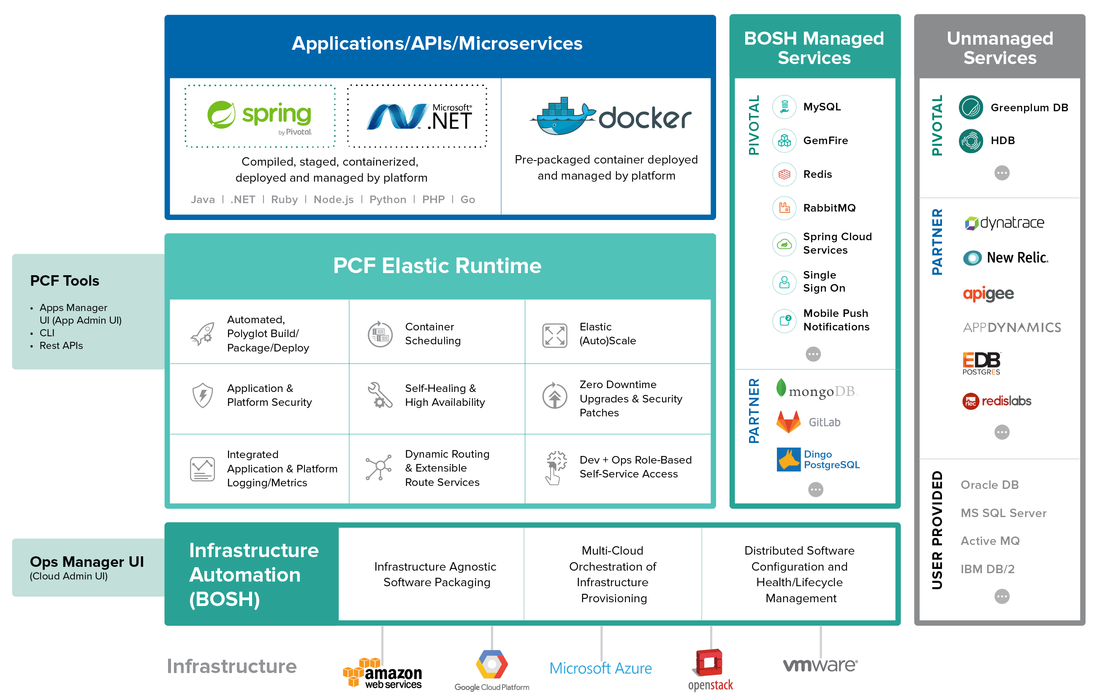

Slide 18
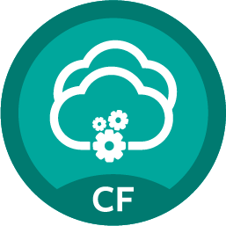
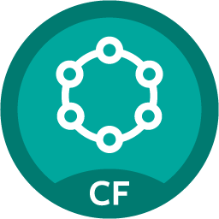

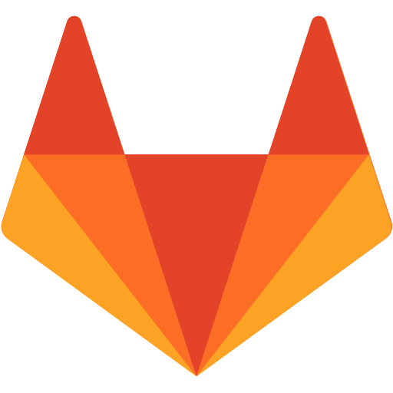
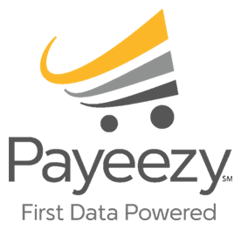
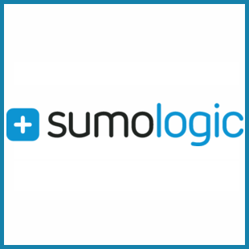
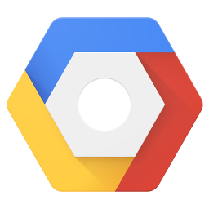
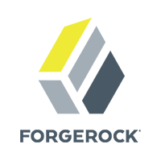

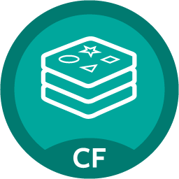
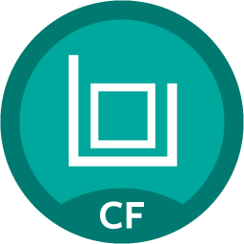
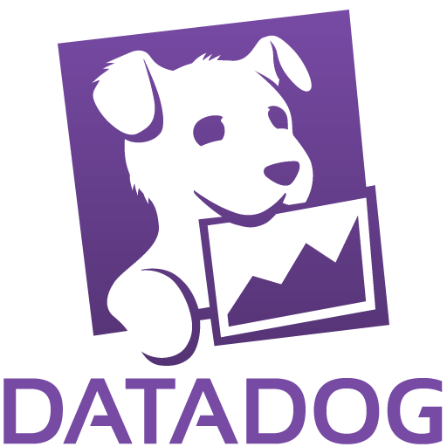
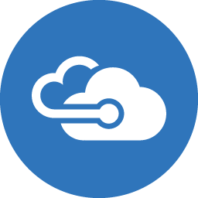
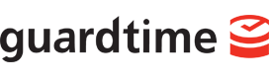
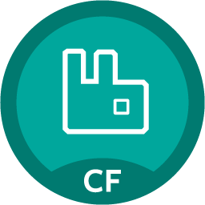
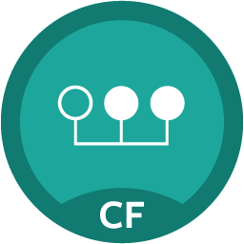
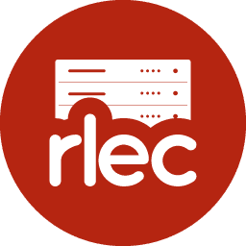

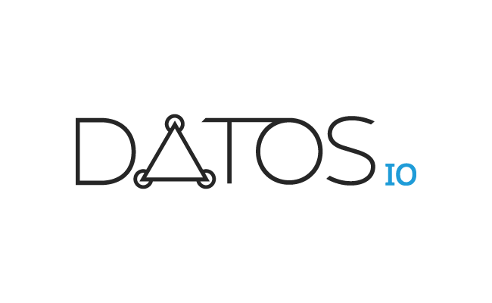


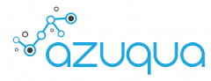

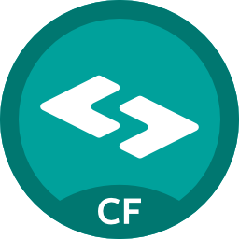
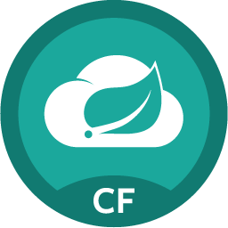
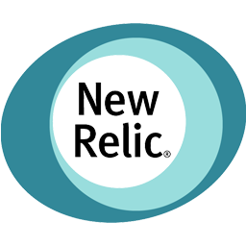
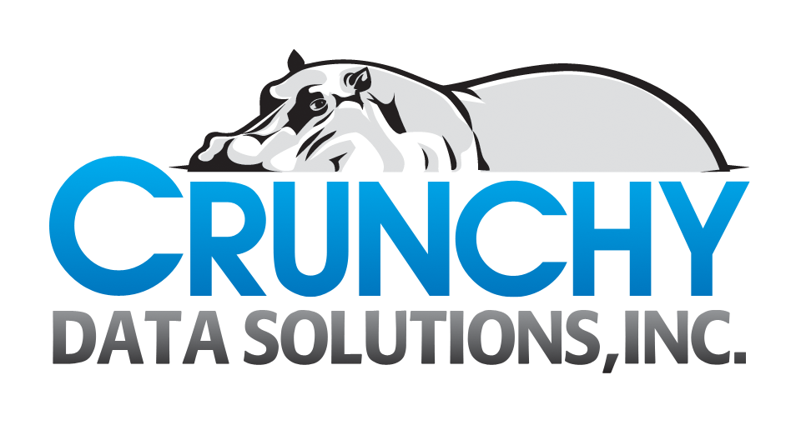
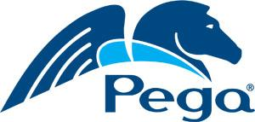
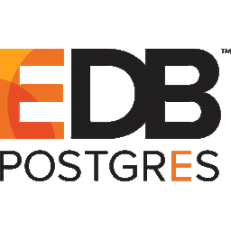
Application Services
Pivotal Cloud Foundry Service
Broker for AWS
Pivotal
Partner
In-Progress
Map
cf bind-service
<app> <service instance name>
Datastax
Dingo
PostgreSQL
GitLab
MySQL
GCP Service Broker for PCF
Dynatrace
Ruxit
Redis
Risk CS
Microsoft Azure Service
Broker for PCF
App
Instance
Service Broker
API
User Provided
App
Instance
Dynatrace
AppMon
Redis Labs
RabbitMQ
Session State
Caching
Cloudbees
Jenkins
Unmap
cf unbind-service
<app> <service instance name>
Log Search
Spring Cloud
Services
Notes:
APPLICATION SERVICES
PCF provides a rich and growing ecosystem of services geared towards simplifying and accelerating the software development lifecycle. Services can include datastores and messaging frameworks for development, CD tooling such as Concourse, debugging via Zipkin, performance analysis with New Relic, etc. The services are available from Pivotal and our partner ecosystem. Customers can also convert deployed middleware into services that can be consumed by apps on PCF.
Service Types & Developer Experience
Pivotal Cloud Foundry supports 2 kinds of services, those that are platform managed and accessible via a service broker, and those that represent arbitrary user provided services (e.g. Oracle database). The former can be instantiated from a Service Marketplace which provides a collection of services (that have service broker API implementations) that an IT operator has made available for developers to use. Developers can create a service instance from such a service. Cloud Foundry then uses the Service Broker API for the service to execute the lifecycle events for the service, e.g. provisioning/deprovisioning. Provisions resources for the service carries service specific semantics, e.g. provisioning might imply a database schema or an account in a SaaS service. Alternatively, developers can create user provided service instances by manually associating a service instance name to service end points (URL/port) and credentials for a service that is separately being managed (e.g. Oracle database).
In both cases, a service instance is created which developers can bind to or unbind from applications. A bind operation simply implies that running instances of the application receive the service connection information via environment variables. The platform handles injecting them in the right containers corresponding to the desired application. Unbind implies the opposite, removal of the connection information.
Note, like user provided services, a service broker provides maximum flexibility for how the underlying service implementation is implemented, deployed and operated – it’s API implementation appropriately defines the service broker API semantics for the particular case. For example, the underlying service may run on the Cloud Foundry elastic runtime, or be deployed using Bosh alongside Cloud Foundry, or even be a SaaS service. Also, the broker can be running anywhere: on the elastic runtime or somewhere in a different cloud. Customers can also implement their own service brokers.
All services are bound to applications in the same/consistent manner. Once bound, PCF handles actually provisioning app instances with service connection and credential information, even when the app instance is restarted, scaled or otherwise scheduled/moved. Service information is provided to app instances via environment variables, in keeping with 12-factor principles. Thus, PCF minimizes the service discovery, service binding, credential management, and other overhead of mapping services to, dynamically orchestrated applications deployed on PCF.
The full listing of the services ecosystem for PCF can be reviewed at network.pivotal.io. This site also features a community page (network.pivotal.io/community) that includes additional (unsupported) services contributed by the broader PCF community.
Services Ecosystem
We continue to grow our services ecosystem, with new services and partners continuing to be added rapidly. Pivotal develops certain core services itself, e.g. GemFire session state caching, MySQL, RabbitMQ, Push Notifications. Other services are provided by partners, e.g. CloudBees, NewRelic, etc. Finally, Pivotal continues to invest with its partners and has a large pipeline of partners with whom we hope to provide an application service soon. Services can be running anywhere; some are bosh deployed alongside PCF, others may be SaaS services. Please check with network.pivotal.io to see how a particular service is implemented.
Public Cloud Services
In addition to services provided by ISVs, it is important to point out that Pivotal is working with the key public cloud providers (Amazon, Google, Microsoft) to provide a means to access the services ecosystem available with those clouds. Pivotal has already developed the AWS service broker, and Google has developed the GCP service broker. A service broker for Azure is in the works as well.
------------------
Do we talk about buildpacks. They are not services per se, but do help accelerate development of certain classes of applications, e.g. Mendix/Tibco.
Find out about Community on network.pivotal
Need to figure out structure of services ecosystem – by type (bosh/non-bosh, buildpack), provider (pivotal/partner), class (datastore, messaging, etc.) or other
Should we call this building blocks – Spring + Services + Buildpacks (btw, we discuss what a buildpack is after this slide, so perhaps talking about them here is premature)
Are Bosh deployed services upgradable w/ zero downtime
Where does the broker run
They don’t know yet what Concourse is or what Zipkin is
What is our services strategy/roadmap? Do we mention Services strategy?
Do we mention Bosh Add Ons?
Other Building Blocks: buildpacks to build mobile apps from Mendix/Tibco, - do we add?
Are all bosh managed services supported on all cloud infras?
Why build Service Brokers? What is advantage.
Do we mention Private Service Brokers here (or later)
Do we define how services work in PCF?
Add Mendix?

Slide 19
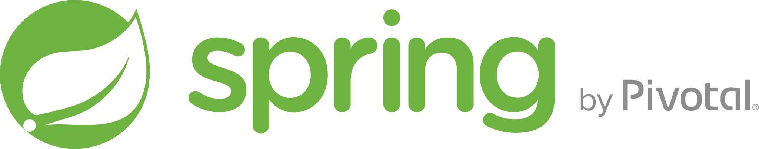
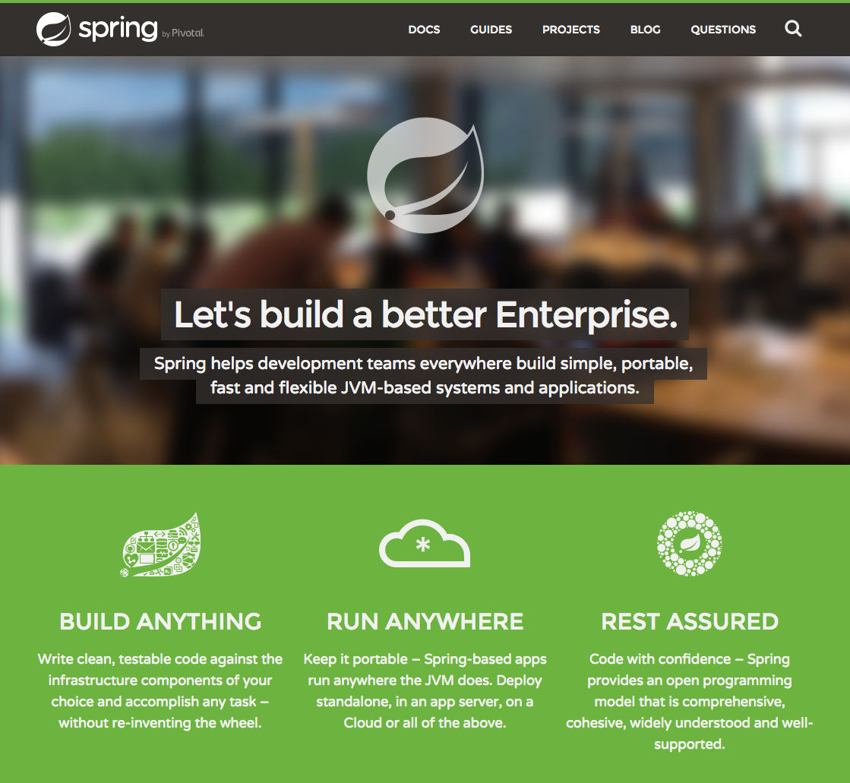













Spring by Pivotal
Code Clarity
Fewer LoC/Lower Complexity
Less Technology Debt
More Time Spent on Business Logic
Better Test Coverage
Complex Enterprise Logic Handled by High Quality OSS Components
Faster code completion
Notes:
Need for Frameworks
Building enterprise applications is a complex affair. Along with business logic, developers have to take care of various non-business concerns such as data access and persistence, transaction management, I/O, authentication, security, etc. In addition to these horizontal cross-cutting concerns, enterprise applications require further specialized support for different types of applications: web, mobile, batch, stream, reactive (event-oriented), etc.
In the cloud era, building distributed, cloud enterprise applications is an even more complex affair. Applications are comprised of distributed, asynchronous components that require additional support, e.g. service discovery, failure detection and recovery, leader election, distributed sessions, global locks, etc. Such applications are subject to various outages and must remain resilient through new classes of failure scenarios.
Much of the complexity of building enterprise applications has been abstracted away through frameworks – collections of reusable libraries of functionality that allow developers to focus on the business specific needs, and defer much of the above infrastructure complexity to the frameworks.
Spring.io
Java, as the dominant programming language in the enterprise, has many such frameworks. Nevertheless, the most popular framework that has emerged over the past decade is Spring – an open source project stewarded by Pivotal. In addition to the richness of reusable framework components that accelerates new application development, another key factor in its popularity lies in the programming model it facilitates.
Through techniques such as Dependency Injection and Aspect Oriented Programming, it promotes a programming model that allows horizontal functionality (e.g. data access or transaction management) to be externally configured and “injected” into the application at runtime, thereby allowing the application source code to remain “clean” (i.e. maximally focused on the business logic) rather than being intertwined with other concerns (e.g. security, data access, etc.). This results in several benefits, including:
Focus on Application Logic – Spring allows the developers to focus on the application logic rather than be distracted by these other important, yet extraneous, concerns. Thus developer productivity is higher.
Code Clarity and Quality – With less code that primarily focuses on the application logic, the code is more likely to be readable and simpler, and developers are less likely to introduce bugs. And, application logic requires less test coverage and is easier to debug.
Defer to High Quality, Robust Framework – Deferring application infrastructure functionality to battle tested, open source code increases the overall stability of the application and prevents application developers from introducing bugs while trying to develop complex, infrastructure functionality.
Spring.io
What: The Spring IO project is the core Spring project that provides Aspect Oriented Programming and Dependency Injection support, as well as baseline functionality for data access, web application development, messaging etc.. Spring Boot builds on this foundation to provide a streamlined development experience.
Why: It provides the foundation for other Spring projects as well as basic web application development support.
Spring Usage
The Spring framework captures industry best practices and software architecture patterns in an OSS package. It consists of 20+ projects that add comprehensive functionality for particular areas of concern. We highlight a few here that provide significant value for cloud native application development. Spring is distributed under an Apache 2.0 license and is in widespread use in the F2000.
Netflix is a well known contributor and user of Spring.
Pivotal is also the steward of the OSS Spring project. Pivotal employs most of the active Spring committers (approx. ~2/3 as of 2016)

Slide 20





Spring Boot – Microservices Foundation
package hello;
import java.util.Arrays;
import org.springframework.boot.SpringApplication;
import org.springframework.boot.autoconfigure.SpringBootApplication;
import org.springframework.context.ApplicationContext;
@SpringBootApplication
public class Application {
public static void main(String[] args) {
ApplicationContext ctx = SpringApplication.run(Application.class, args);
...
}
}
Convention
Quick Start
Configuration
POM Starters
ALSO:
/autconfig
/beans
/metrics
/configprops
/env
/shutdown
/<custom>
Auto Configure
From 0 to app in < 5 min
Focus on Business Logic
Enterprise Java maturity with dynamic language productivity
AutoConfigure
Tags the class as a source for Spring Beans
Asks Boot to automatically add beans based on classpath
Tell Spring to look for other components, configs etc. in the same package
Spring Boot
AutoConfigure
$ java –jar myapp.jar
Dev Tools
Actuator
Notes:
SPRING BOOT – MICROSERVICES FOUNDATION
What/Why Spring Boot
Spring provides a rich java framework with many sophisticated capabilities. Getting started with them and using them effectively can be a complex undertaking. Spring Boot (“Boot”) is a sub project of the Spring.io project and provides a framework for developing, packaging, deploying and running Spring applications that is designed to not only alleviate the learning curve of getting started with Spring, but also to streamline and accelerate many common activities that developers spend significant time on during the full lifecycle of application development activities. As a result developers can become more productive. Spring Boot accomplishes this by providing an opinionated approach to building a Spring based application and consuming Spring capabilities, i.e. it provides a reasonable default approach, which the developer can easily override.
WHAT: Enterprise application development framework consisting of pre-built, opinionated configuration for Spring, without the need for developer defined XML configurations. Spring Boot detects and auto-configures Spring modules based on developer code. Spring Boot embeds app libs + lightweight app servers for a standalone, cloud friendly JAR deployment.
WHY: Helps make Spring accessible to developers by eliminating upfront learning curve and configuration complexity and time. Still enables access to full Spring functionality if needed. Significantly accelerates application and microservices development time.
Spring Boot – Key Capabilities
Spring Boot provides a solid foundation for java microservices – not only streamlining the rapid development of microservices, but also simplifying the deployment and management thereof. Spring Boot helps build high quality applications rapidly. Let’s look at some key capabilities:
Quick Start – Developers can use a Quick Start mechanism to specify high level spring capabilities required (e.g. MVC, security, JDBC, etc.), and generate a simple running project structure comprised of all the dependencies and build specifications required for the type of application being developed. There is no code generation, except for 1 shell class for the Spring Boot application. The project can be generated from the web (start.spring.io), CLI or from within a java IDE such as Eclipse or IntelliJ using the Spring Tool Suite plug-in. Thus, developers can quickly get a working project up and running and remain focused on building custom business logic. With very little set up, they can start building custom business logic by tailoring and overriding default setup/configuration.
Dependency Management – Developers spend a lot of time managing dependencies for their development/production environments, i.e. ensuring they have the right jars, in the right location and with the right versions. Managing version compatibility is a significant productivity drain that Spring Boot eliminates through automatic dependency management using Spring Boot Starters. Spring Boot Starters are dependencies that allow specifying high level capabilities desired in the application (e.g. Java Persistence, Rest web services, etc.) and the Spring Boot framework configures the project to use the right versions of various Spring jar dependencies so they work well together. This is a big deal as lots of potential dependencies need to be managed in real-world projects, before developers can even begin coding. With Spring Boot, these dependencies are configured and managed transparently, leaving developers to focus on their application.
Auto-Configuration – Setting up any framework for an application requires a lot of boiler plate configuration. Spring Boot streamlines this process by auto configuring beans (framework objects) and dependencies to let developers focus on business logic. If Spring Boot detects the presence of Spring dependencies in the class path, that the developer has not explicitly configured, it will automatically configure them using simple, intelligent, default conventions. (Hence the term “Convention over [explicit] Configuration”) However, developers can easily specify alternative configurations and properties via various mechanism, including command line, property files as well, environment variables, etc. This is a significant productivity boost as registering, configuring and setting up spring beans takes significant developer effort, that is now automated so developers can instead focus on developing business logic.
(Fat) Jar – Spring Boot applications can be packaged as standalone, executable “fat” jars that include within them not just the application code, but also all spring dependencies as well as an auto-configured/auto-deployed web server and servlet container (e.g., tomcat, jetty, undertow). This simplifies application deployment esp. for microservices in a cloud context that relies on replicating instances to support horizontal scale out: self-contained, single artifacts can be moved around and easily executed directly without the need for unpacking and start scripts for application artifacts. The simple, self-contained nature of the Boot application comprised of 1 artifact allows deploying the application to any runtime context, and configuration to be supplied externally (e.g. command line, environment variables, configuration service, etc.). This helps avoid one of the key pain points that slows down AppDev: the disparity between dev and production packagings, deployments and environments that is hard to debug because of the deployment complexity. Also, as a result of this simple packaging and deployment approach, AppDev can now avoid going through the complexity and expense of installation, configuration and deployment workflows common with traditional app server deployments (e.g. WebLogic), and even configure Boot applications to be deployed to run as background services. Boot applications can be deployed in minutes, instead of hours or days.
Dev Tools – Spring Boot also provides various developer tools that boost productivity. Two of these tools include Automatic Restart and Live Reload. Automatic Restart detects changes to application files in the classpath and triggers an app restart so that the developer can test the latest code locally without manually shutting down and restarting the application. (Developers can configure it to ignore certain files/paths). Similarly, built in support for LiveReload in Spring eliminates manual browser refresh; It automatically triggers a browser refresh so a developer can check if their code changes have taken effect without needing to manually initiate and wait for a refresh. Given that developers make small changes and validate their changes continuously during development, these seemingly minor features have a significant impact in the long term on the dev-test workflow and developer productivity.
Actuator – By including the appropriate dependency, Spring Boot provides support for “actuators” that serve as production ready, sensing mechanisms that can provide insight into the operational status of the Spring Boot application (or microservice) for proper monitoring and management. These actuators (that can be also be authenticated endpoints) can provide insight/telemetry on current configurations (e.g. environment variable settings, current spring bean configuration settings), health (e.g. if the service is up or down), metrics (e.g. number of requests, memory consumption), or custom metrics (e.g. total amount of sales today). Actuators can also be used to manipulate the boot application, e.g. shut it down. With actuators, developers do not need to develop overhead code to capture and report all this data, leaving them free to focus on differentiating business functionality. Actuators can be accessed as Rest endpoints, or via a shell interface or JMX beans.
Spring Boot has been created with a singular focus - Make developers productive, so they focus on core business logic. For example, a dev can now write a robust database connected rest service in 10s of lines of code, which is unheard of in traditional app server based enterprise application contexts. Boot does all the rest of the heavy lifting. Spring Boot dramatically simplifies the developer experience for Spring Applications and has made Spring accessible by more developers by eliminating the upfront learning curve, configuration complexity and time. However, it still enables access to the full Spring functionality if needed. Spring Boot significantly accelerates application and microservices development time. Netflix is a well known user of Spring technologies, including Spring Boot.
Why is Spring Boot Provides a Microservices Foundation
Spring Boot provides the foundational technology for building microservices. Ideally, microservices support incremental change, horizontal scalability, deep telemetry, a few focused concerns, and allow rapid change. Spring Boot makes it easy to achieve all these goals:
Incremental change: Spring Boot default configurations and annotations allows developer code to be simple and business logic focused making incremental changes easy and fast to make. The associated Dev tools make it fast and easy to validate them as well.
Horizontal scalability: The self-contained nature of the fat jar makes the runtime artifact easy to move as a single unit as well as to replicate to scale up/down
Deep Telemetry: Spring Boot actuators enable gaining not just code-level application insights, but also business relevant metrics.
Few/Focused concerns: Quick Start and Dependency Management make it easy to skip past boiler plate set up and configuration to get to code development. Further, annotation based config keeps the code clean and focused on business logic.
----------------
Spring Boot is bringing productivity of dynamic languages like Ruby on Rails, Perl, PHP and more to the Java 6,7, and 8. This means that enterprises no longer need to sacrifice the stability, performance, concurrency, and type safety of Java to get better developer productivity – they can have the best of both worlds.

Slide 21









Spring Boot Popularity
10.3M
Monthly Maven Downloads
source: oss.sonatype.org
Notes:
SPRING BOOT POPULARITY
Spring Boot is tremendously popular in developer circles. Why is Boot so successful with developers? Because it focuses on enhancing developer productivity – not only letting them focus on business logic by simplifying most other concerns, but also by making the spring framework itself easier to consume through annotations, autoconfiguration, starter packs, spring initalizr, etc.
If your developers are not already using it (although there’s a good chance they already are), perhaps these anecdotes on its popularity will convince them:
Spring Boot has gained tremendous traction since its release in 2014. As the curve shows, the adoption curve has been steep, and today Spring Boot is downloaded by developers over 4M times per month! Some of them are probably in your organization.
But don’t take our word for it. See what our customers are saying about using Spring Boot as well as PCF. → Review tweets from PCF customers and/or Boot users.
Merecedes
Comcast
Travelers
Liberty Mutual
Netflix

Slide 22
Spring Cloud – Microservices Infrastructure
Spring Cloud Consul
Spring Cloud Data Flow
Common Patterns for Distributed, Cloud Based Enterprise Applications
Spring Cloud for AWS
Spring Cloud Connectors
Spring Cloud Bus
Spring Cloud Sleuth
Spring Cloud Cluster
Spring Cloud Security
Designed for disposable infrastructure in partnership with Netflix
Spring Cloud Config
Spring Cloud Netflix
Spring Cloud Zookeeper
Spring Cloud Task
Notes:
SPRING CLOUD – MICROSERVICES INFRASTRUCTURE
Spring Boot forms the foundation for building your microservices. But how do you build a cloud native application built as a collection of distributed microservices that interact with each other? What are best practices and patterns for coordinating their interaction? What runtime scaffolding and support is required to support their interaction? That’s where Spring Cloud comes in.
Spring Cloud picks up where Spring Boot leaves off. Spring Boot lets you build individual microservices quickly. Building upon this foundation, Spring Cloud provides the supporting infrastructure components and complex, distributed computing patterns that are critical for efficient and robust microservices architectures. Furthers, it packages them in the Spring programming model and framework.
The Role of Netflix
Netflix: Netflix is well known as an early pioneer and adopter of microservices patterns. In the process of building Netflix, they encountered many of the complexities of distributed computing based on microservices, and conceived and developed many of the design patterns and components required to develop robust microservices based applications. A lot of this software was made open source under the Netflix OSS project. Much of this software eventually became integrated into the Spring programming model under Spring Cloud. (Of course Spring Cloud also has other components that did not originate at Netflix). Today, the code has come full circle. Netflix now uses the Spring Cloud project components (that wrap some of Netflix’s original components) to build its microservices. This is a testament to the power of Spring and its programming model as well as the battle readiness of the components.
Sample Projects
There are various components to Spring Cloud that provide critical building blocks for distributed, microservices based applications. Let’s look at a few:
Spring Cloud Cluster – When building microservices, it is critical to sometimes operate them as a cluster in order to ensure high availability and low latency. Spring Cloud Cluster (SCC) provides implementations for various patterns common in clustered scenarios, e.g. leader election or global resource locks. In addition, SCC provides implementations of these patterns for particular well known OSS services that can be deployed ,e.g. Apache Zookeeper used for distributed configuration or synchronization between microservice instances.
Spring Cloud Bus – Multiple services in a cloud native app need to be able to communicate and coordinate, e.g. propagate changes to the application state that one node knows about, to the other nodes in a cluster. Spring Cloud Bus provides an event bus for linking services and service instances together with distributed messaging.
<TODO – more project descriptions>
We talk more about Spring Cloud Dataflow, Spring Cloud Task, Spring Cloud Config, and other projects next.
Spring Cloud components provides implementations for various distributed service scenarios that are difficult to build from scratch and get right easily. With Spring Cloud, building sophisticated microservices applications becomes easy, with Spring Cloud components providing the guard rails to ensure the applications are built on a reliable distributed computing foundation.
---------
TODO: Add descriptions for the below:
Spring Cloud Bus – s
Spring Cloud Netflix – s
Spring Cloud Sleuth – s
Spring Cloud Data Flow – s
Spring Cloud Connectors – s
Once you build a rest service – you will need central config
Distributed systems arch – 12 factor – config – passwords, hostnames, etc.
Change config in a single place
Change things live
Patterns: Centralized Configuration
Service Registry – name to IP/port → helps with client side load balancing
Zuul gatekeeper
API Gateway
Messaging
Circuit –Breaker - Resiliency
Tracing
Sleuth – latency + failure relationships

Slide 23





Spring Cloud Data Flow – Data Microservices
Deploy and Management
on PCF
Spring Cloud Data Flow Server
Developer Benefits
Simple programming model
Composition: Streaming and Batch
Readily Available Building Blocks
Messaging Middleware
CI/CD + TDD Friendly
Operator Benefits
Canary/rolling upgrades
Dynamic failover and auto scaling
Easy Failure Isolation
Operational Dashboard
Orchestration Service
for Data Microservices
Process
Reference Metadata
Boot
App
Boot
App
Boot
App
Stream
Notify
HTTP
Boot
App
Boot
App
Boot
App
Boot
App
Transactional DB
Filter
Enrich
Data ingestion
Real-time Analytics
Complex Event Processing
Data Import/Export
Boot
App
Task
Boot
App
cron, trigger, manual
Analytics DB
ETL
Notes:
SPRING CLOUD DATA FLOW – DATA MICROSERVICES
Why Data Microservices
Data is central to any application, and a significant portion of an application’s functionality centers on its capture, management, integration, and transformation. Hence, one of the key classes of microservices that most organizations will build will be data microservices – microservices dedicated to managing and manipulating data. Building on this possibility, Spring Cloud Data Flow is a cloud-native orchestration service for composable data microservices on modern runtimes that dramatically simplifies build data processing applications and pipelines by providing an orchestration framework for user provided data microservices (boot apps). Spring Cloud Data Flow (SCDF) builds on Spring Cloud Stream, Spring Cloud Task, and related projects. Various use cases are possible, including data ingestion, real-time analytics, complex event processing, data import/export, etc.
Key Components
Spring Cloud Data Flow: SCDF provides the orchestration service and implementations of relevant patterns and best practices to support both stream oriented (continuous) and batch oriented data processing workloads on PCF and other platform runtimes. It supports the design, creation, registration, unit test, troubleshooting, deployment, scaling, and monitoring of streaming and task/batch pipelines on Pivotal Cloud Foundry (as well as other platform runtimes, e.g. Kubernetes). Developers can create SCDF workloads by composing custom data microservices (Spring Boot applications) as building blocks that can be integrated with built-in starters (e.g., data sources and sinks) to compose a streaming or task/batch pipeline.
Spring Cloud Stream: Spring Cloud Stream is a lightweight event-driven microservices framework to quickly build applications/streaming data pipelines that can connect to external systems (ex: kafka, cassandra, mysql, hadoop, etc.) to process a process a continuous data stream. The stream is architected as a set of stages, each comprised of a Spring Boot application (data microservice). Each stage communicates with the next using a persistent publish/subscribe messaging mechanism such as appropriately configured Rabbit or Kafka instances.
Spring Cloud Task: In contrast to Spring Cloud Stream, Spring Cloud Task is a microservices framework to quickly build applications that perform short-lived, finite amounts of data processing (ex: batch-jobs) that start, complete their processing, and then shutdown. They can be triggered automatically based on time, other streams/tasks or manual intervention.
The Spring Cloud Data Flow project provides key features that help accelerate both the developer and operator workflows around streaming and task/batch processing.
Developer Benefits
Simple Programming Model – All microservices that comprise a SCDF workload (streaming or task/batch) are simply Spring Boot applications, just like other microservices you develop. And they are pluggable into the framework. Thus, there is no new programming model or framework for developers to learn.
Composition: Streaming and Batch – Any microservice can easily be moved around, swapped out, or reused in new pipelines. This creates tremendous flexibility and speed to build pipelines from a “library” of previously created/vetted/tested data microservices.
Readily Available Building Blocks – SCDF provides a set of starters to quickly build powerful pipelines. These starters include data source/sink building blocks e.g. file, http, database, mail, syslog, gemfire, s3, etc. as well as processing components that take data from a source, process it, and send it to the sink, e.g. a Filter processor that can be configured to allow or block the transmission of an inbound message based on certain criteria.
Messaging Middleware – Individual microservices communicate with each other via messaging middleware (e.g., using publish/subscribe as opposed to Rest API calls) such as Kafka or Rabbit. Messaging middleware decouples individual microservices from each other, and provides flexibility to not lose messages if processing capacity at any stage is lagging, or even if a stage goes down and comes up later. Also, message based processing allows scaling individual data microservices (at different stages) separately as needed – each instance can just consume from the pub/sub queue, for example in round robin fashion or based on whichever instance is free. This supports load balancing and failover.
CI/CD + TDD Friendly – Each data microservice can be tested and deployed independently of the other, providing developers the freedom to develop/test/deploy independently and the organization to leverage this parallelism to move fast.
Operator Benefits
Canary/Rolling Upgrades - Currently, we take advantage of canary/rolling upgrade support from within PCF itself. Similar to blue-green deployments on REST based apps, there’s an equivalent model that applies to messaging apps, and it is documented in the reference guide.
Dynamic Failover + Auto Scaling – PCF provides dynamic failover and autoscaling of (individual microservices of) data workloads deployed to it via the SCDF Server.
Failure Isolation – Failures are easy to isolate as the processing is broken up into stages and not in a monolith. Logging and Metrics from PCF for individual data microservices make it easy to track down where problems might be occurring. Also the persistent messaging allows you to take a microservice out of commission temporarily without loss of data.
Operational Dashboard – SCDF provides a dashboard that supports visual design of pipelines as well as creation/deletion/deployment/undeployment/launch and shutdown of pipelines and tasks. In addition, it allows creation of simple analytics dashboards to monitor counts (e.g. messages, transactions, etc.) occurring in the pipeline. (Note that there is a domain specific language that developers can use to create the streaming and task/batch pipelines – they do not need to only rely on the dashboard for this.)
Example
The example shows an sample pipeline and task and how they might potentially interact. The key elements are as follows:
The user creates various boot applications for the Enrich, Process, Notify and ETL microservices, and creates the pipeline and task with the Spring Cloud Data Flow Server (a bosh-managed, PCF Tile). Let’s think of a complex event processing medical scenario where you are monitoring various patient readings in various hospital rooms.
The Stream consists of the following stages:
Filter: Reuse one of the building blocks available in SCDF. It decides whether or not to bother processing some data. For example, it only processes patient temperature readings if they are above 98.6 degrees or if the heart rate is higher than 80 per minute
Enrich: User created boot app that accesses a reference database to decorate the incoming message, e.g. uses the location id to look up the room location.
Process: Check if the temperature reading for this patient in a sliding window of the past 30 seconds has consistently been high and correlate his/her heart rate also has been high. Store the data in the sliding window.
Notify: If the temperature reading and heart rate is up, log the event, and notify a nurse.
The Task consists of an ETL job where patient vitals are sampled and averaged every minute and stored in a historical database.
The user uses the SCDF server to deploy the stream and task to the PCF elastic runtime.
The stream begins accepting HTTP traffic and data flows through the various stages.
The task “wakes up” every so often (clock) and performs some batch ETL job. It can be triggered by time, or a stream action or by the user directly (e.g. from the dasboard).
Use Cases
Data Ingestion – Collecting data, e.g. extracting and logging key events of interest from server logs
Real-time Analytics – Collecting real time trend information, e.g. Consumption in a supply chain → how many blue shoes have been sold across the country and how many remain in my warehouses. Helps determine what action to take, e.g. move inventory, order more shoes, etc.
Complex Event Processing – Look for multi-factor events of interest. See patient example above.
Data Import/Export – Move and transform data between repositories, e.g. file or ftp source that is put to hdfs or relational database table data converted to graph data model and stored in a nosql db.

Slide 24




Spring Cloud Services
Microservices Management
Development
QA
Production
Boot
App
Boot
App
Boot
App
Boot
App
✗
✗
Boot
App
Boot
App
Boot
App
Boot
App
Boot
App
✗
Boot
App
Boot
App
Boot
App
Circuit
Breaker Dashboard
Config Server
Service Registry
Turbine
Zero Downtime Upgrades • High Availability • Stateful Service
Notes:
SPRING CLOUD SERVICES – MICROSERVICES MANAGEMENT
Why Spring Cloud Services
Consider an application comprised of a collection of microservices. There are several issues that need to be addressed in this scenario: how to pass configuration to these services upon startup, how a service finds and connects with other services and how to manage (inevitable) failures.
Spring provides most of the critical building blocks for such management and support of microservices based distributed cloud applications. Developers can easily consume those building blocks to develop robust applications. However, even then, using those components to build such distributed applications is a non-trivial task. For example, Spring Cloud components such as config server and circuit breaker dashboard can be used to build a services to distribute configuration information and to monitor service runtime status. But, actually standing those components up as running services, ensuring they are secure, highly available, scalable, policy driven, etc. requires a lot of work.
Time to market is key. Thus, AppDev’s time is better spent focusing on business logic that helps the business compete more effectively and not on complex infrastructure concerns that essentially constitute “undifferentiated heavy lifting.” With that in mind, Pivotal has developed Spring Cloud Services, a collection of running services built with Spring components that are secure, highly available and available with the PCF platform. They are an opinionated deployment and configuration of various Spring components, e.g. Config Server, Eureka Service Discovery, etc., and they solve a few of the key concerns enterprises encounter when deploying multiple microservices. Thus, developers can spend their time by focusing on building innovative applications.
The current set of services offered are Config Server, Service Registry and Circuit Breaker Dashboard. They are packaged as a PCF Service tile. Security is provided by PCF platform authentication. PCF also ensures high availability for the services. Applications can bind to them as they would with any other service on PCF and interact with them using appropriately specified clients for these services (via Maven dependencies). Thus, developers can focus on writing microservices for their business and defer the microservices management overhead to Spring Cloud Services.
Spring Cloud Services is a single bosh deployed service that provides high availability and zero-downtime upgrades. But, the single deployment actually includes three different services: Config Server, Service Registry, Circuit Breaker Dashboard.
Pivotal provides client libraries to access Spring Cloud Services with both Java (Spring) as well as .Net (Steeltoe).
Config Server
Problem: Config Server allows distributing application configuration information to one or more applications in a consistent and automated manner. It goes a step beyond native configuration setting on PCF based on environment variables, e.g. it makes possible updating not just multiple instances, but multiple applications with little manual effort.
How it Works: Developers can store configuration information in a versioned store such as SVN or Git. Config server is configured to search a particular repository to collect configuration information. Applications can query the config server to get configuration data. The service uses the Spring Cloud Config project.
Benefits: Config server provides various benefits including
Externalized configuration: in line with 12-factor tenets
Consistent Configuration Distribution: a consistent means to distribute different configuration data based on runtime context as the application moves along the Continuous Delivery pipeline and is deployed to different environments (e.g. integration testing, QA, production)
Versioning: A means to version configuration data by using a versioned data source such as Git or SVN
Bulk Configuration Data: You can specify a lot of config data into git managed property files that would be unwieldy to specify via environment variables
Service Registry
Problem: In a dynamic, distributed environment where new services can appear and software artifacts are deployed in a dynamic manner (across different machines, in a different location each time), it is hard to tell which services are available and where they are running. A service registry provides a central repository and source of truth so that services and application components can find each other and start communicating.
How it Works: “Producer” services startup and register with the Service Registry. They provide regular “heartbeats” to the Service Registry so the registry knows that they are still available. “Consumer” services connect with Service Registry to find which (producer) services are available as well as their addresses (e.g., IP/port or url route), and then connect with them. (Note, a service can play both a producer and a consumer role depending on context.) The Service Registry is built on the Spring Cloud components that wrap the Netflix Eureka service discovery server and client functionality.
Benefits: Service deployment can be dynamic. There is no need to hard code or pre-specify microservice names/locations, allowing the application to evolve without significant reconfiguration disruption. Again, this is also useful for applications/services as they move through a Continuous Delivery pipeline, because they can use the registry to dynamically look up which services to connect (e.g. dev database or production database) to depending on runtime context (dev, test, qa, production). NOTE: The Service Registry itself however has to be bootstrapped to all services so they know how to find it.
Circuit Breaker Dashboard
Problem: In a distributed environment, various services depend on other services, which in turn depend on others. If one of them fails or experiences latency, the calling service can similarly “appear” to fail. This process can spread through a microservices deployment, making it difficult to isolate the failure as well as recover from it. In the worst case, it can cause blocking scenarios where one service hangs on waiting on another and does not serve new requests. This can lead to cascading failures.
How it Works: The Circuit Breaker dashboard provides an implementation of a circuit breaker pattern. The circuit breaker patterns makes it possible for a calling service to detect latency or failure in a downstream service (e.g. if 5 calls in a row time out), and temporarily not call it, i.e. “back off” (open circuit state), thereby reducing load on it and allowing it to recover. During this time, it defaults to a developer specified method that specifies what to do while the downstream service is not being called (e.g. return an error message, return a default value, redirect to another service, etc.). After some time, the calling service attempts to make the call again, and depending on the outcome either stays in the open circuit state if failure persists or closes the circuit if the called service responds. Finally, the calling service also reports its experience and current state to a central dashboard that aggregates an visualizes the global state of the microservices deployment. This service is built on Spring Cloud components that wrap the Netflix Hysterix and Turbine OSS projects.
Benefits: This service provides the following key benefits to a distributed microservices deployment:
Resiliency: Circuit breakers help the deployment avoid cascading failures from a low level service all the way up to the end user.
Self-Healing: The back-off mechanism built into the Hysterix client to temporarily “open” the circuit breaker and not make calls allows the down stream service to either recover or restart.
Monitoring: The dashboard provides a centralized means of keeping track of the overall health of the distributed deployment.
NOTE: As a developer, you should not be concerned about the implementations we have used to provide the services (e.g. Hysterix, Turbine, Eureka, etc.). These can be swapped out any any time (or multiple ones might be provided in the future). However, your contract with the service will remain stable and allow your application to continue to function.
Screenshot
We show a screenshot of what a circuit breaker dashboard may look like for s ample deployment. It shows the various services deployed for a sample catering application. Key items to highlight include:
Circuit status: Open or Closed implying whether the service is accessible or not.
Request volume: Shows how many requests are coming in. You may decide to scale the service based on load.
Request Latency: The time it takes for the service to respond to a request (median and mean)
-----
Talk about cloud bus?
Not mentioning scoping of services to a space as that will change.
Future roadmap?

Slide 25
DELIVER Fast
Notes:
Let’s look at how Pivotal can help you build code rapidly
Later we will discuss how Pivotal can help you test, deploy and manage applications quickly and reliably.

Slide 26


Streamlining Developer Workflows
Reducing Overhead
Design and Coding
Brainstorming
Source: “Electric Cloud LinkedIn Survey to software developers”
Administrative tasks
Managing Environments
Waiting for Test/Build
Average Hours/Week
Snowflake Automation
Structured Automation
Ad hoc, Incomplete Automation
Complex/Custom Configurations
Infrastructure Failure Sensitive
Redundant work for cross-cutting concerns
Difficult to Port/Replicate
Maintenance Overhead
Consistent Contracts
Fully Automated, Repeatable platform managed DevOps processes
Developer + Ops Friendly Constructs
Easy to move/re-architect apps
Infrastructure Failure Agnostic
Platform
Manual, Slow, Inflexible, Error-Prone
Automated, Fast, Flexible, Safe
Notes:
STREAMLINING DEVELOPER WORKFLOWS
Developer Productivity Drain – Need for Automation
Probably the “best known secret” of enterprise AppDev is that most enterprise developers do not spend all their time working on code. Instead they are tasked with a lot of other activities that are peripherally related to development, e.g. trying to get a build environment, or working on configuring or tweaking it. This loss of productivity is a drain on AppDev and hinders its ability to deliver software fast. Here is a sample survey from Electric Cloud that shows this general trend. Although the survey is a few years old, the situation is generally unchanged in most enterprise software organizations.
More generally, there’s a lot of activities that take place once code is completed to get into a production running state. And developers have a big role to play in many of them since they are the ones developing the code and have the expertise. A lot of things that require manual, time consuming effort and intervention from developers are actually avoidable. Many of these activities could benefit from automation, and as a result help alleviate the productivity drain on developers (and also Operations personnel – but more on that in the Ops deck). Automation is needed for many things. For example,
Provisioning/Configuration – Provisioning compute infrastructure can be made API or portal driven. Installing an OS image, installing middleware, configuring network, etc. are similarly amenable to automation. There are many tools available that can take user preferences and inputs and automate provisioning and configuration of infrastructure.
Deployment – Compiling, packaging, deploying software is a similarly manual, time consuming effort that developers need to engage in to help IT Ops get code into production. Manual “runbook” style deployment procedures inevitably lead to someone forgetting something or misconfiguring something, kicking off a very time consuming hunt for what went wrong that necessarily requires input from developers.
Testing – Testing software can be a very cumbersome process when done manually. However, in a Continuous Delivery environment with a DevOps practice that aims to deliver frequent releases, trying to rely on manual effort can become a huge productivity drain and ultimately become unsustainable.
Monitoring – Trying to manage a distributed application (especially microservices based) can become an insurmountable complexity challenge. If/when problems do occur, tracking down what happened to diagnose and fix things requires monitoring, aggregated logging and dashboards – all of which can be highly integrated and automated.
Management – Scaling, ensuring high availability and updating software in production can also be labor intensive and risky workflows. It makes sense to automate them to reduce risk and enable frequent changes to support elastic demand.
Security – Securely configuring runtime environments, taking preventative actions (e.g. rotating credentials or “repaving” the platform), detecting intrusions, taking corrective action, logging violations, etc. can also be automated.
Thus, appropriate automation is a must.
CONCLUSION: There’s a lot of activities that need to be performed after coding to “deliver” running software. Modern enterprises must embrace automation and tooling if they are to deliver software quickly.
Snowflake Automation
Many forward thinking enterprises have arrived at the same conclusion and have started to build automation for many of the workflows listed above. However well-intentioned, these efforts are generally unstructured and yield “snowflakes” – a unique combination of manual effort, scripting and tooling that works well for a particular project in a particular environment, but one that is fragile and not generally applicable.
They have a few drawbacks:
Generally, such automation is built by stringing together various tools via scripts that invoke them. Where tools do not interface cleanly (e.g. file output from one cannot be consumed by another), additional scripts and/or manual workflows fill in the gap. This leads to ad hoc, incomplete automation.
The number of moving parts that need to be integrated (tooling, scripts, manual workflows) make the automation complex, especially as it needs to be maintained going forward as needs evolve and tools are updated.
They are good at one aspect of a problem, e.g. provisioning and/or configuring runtime environments, but not good at handling other aspects like providing a stable runtime e.g. masking infrastructure level failures such as failed VMs, and ensuring that the app is not affected. As a result, developers end up having to compensate, e.g. by building code for HA into the app that is not really central to the business problem at hand.
Given that the automation does not handle complex scenarios, e.g. failure, developers end up having to build scaffolding around the application to handle such situations. Most of this scaffolding can be made general purpose, but developers end up building it specifically for the app, and reinvent that wheel with each app. Thus, a lot of their time is spent in redundant work for cross cutting concerns that apply to all apps, e.g. high availability.
Lack the consistency and interoperability required between projects, teams and environments that is required for the whole organization and company to go fast. They are specific to the project/environment and lack a general structured approach that is easy to port, i.e. apply to different projects by different teams in different environments (e.g. different clouds or dev/prod/qa).
Ironically, many times these efforts actually drain developer productivity in building automation that then becomes an addition to the organizations technical debt that needs to be maintained going forward.
Structured Automation (a.k.a. Platform)
It’s easy to fall into the trap of implementing a few scripts that automate some parts of various processes. Without structured automation, you can end up having to deal with many snowflake automation processes – e.g. a deployment process comprised of ad hoc, incomplete script based automation that is unique for each application and environment, difficult to port to another cloud and requires significant on-going maintenance overhead. Further, the IT team needs to be familiar with the idiosyncracies of each automation chain. This approach tends to be inflexible, error-prone and reliant on manual effort to tie various pieces of automation together.
In contrast to snowflakes, the notion of “structured automation” is an important one. Structured automation makes promises on what developers can expect (“contracts”) if they meet certain criteria, and then masks the details of how those promises are delivered so that developers do not have to deal with it. For example, structured automation can automate build and deploy for apps in any language/runtime if they propose and enforce a structure for the input and output for the process. Similarly, they can guarantee HA without the app developers having to build additional code to ensure resiliency. Such a guarantee can apply to all apps that run with that automation. Thus, redundant work is minimized.
A collection of automation that enforce such contracts and that work well together is also known as a platform. A platform provides a means to follow processes that remain consistent regardless of the app, environment (on-premise or public cloud), context (dev or ops) or team that is using it. A platform ensures not just automation and speed, but also consistency, flexibility, safety and reliability. And, in the new DevOps world we live in, it should not only provide streamlined support for shared processes (e.g. environment provisioning, configuring and deployment) and fluid collaboration between developers and operators, but also support the specific needs of the Dev/Ops that support their independent missions.
Platforms provide various benefits:
Consistent Contracts: They enforce the contracts for all workloads, thereby creating not only cognitive simplicity for developers and IT operations personnel, but also consistency that leads to smooth development and delivery, and (therefore) speed to market.
The platform controls the different workflows that are required to deliver running software, and thus can control the full automation and integration thereof, thereby avoiding snowflake automation that may consist of an ad hoc combination of 3rd party tools, in-house scripts, and some manual workflow.
The platform can create abstractions (“constructs”) that are natural for developers and IT operators (e.g. application instance) and then consistently deliver those constructs using underlying infrastructure primitives, e.g. containers. This insulates dev/ops from low level details that can vary between different environments and be very time consuming to understand and manage, but not add significant value.
When developers build against contracts, a platform provides an abstraction layer through its contracts that supports portability by allowing apps to run in various contexts as long as the underlying platform runs in that environment. The JVM is a simple example (runs on PC, mac, linux, Android, etc. with little variation in application behavior). PCF is another example as it lets the same application run unchanged in different clouds.
As mentioned above, platforms enforce contracts. Thus, they hide many of the underlying infrastructure details and provide mechanisms to hide infrastructure failure such that the application can operate on the assumption of a stable compute layer. Although this is not actually the case, the abstraction is a powerful one as it allows separation of concerns – the app focuses on business logic, while the platform focuses on horizontal, cross cutting concerns such as high availability (HA). This simplifies the app building process and code, avoiding unnecessary overhead, thereby enhancing speed to market.
A platform lets you eliminate distraction and overhead, and focus on the value added activities for the business. Platforms are developed to introduce structured automation and make software practices easier, faster, safer. Let’s see how the PCF platform can help you deliver software faster.
--------------
Add description of why script based automation is inflexible, error-prone, manual
Add description of why Platform is consistent, safe, …
TODO – Add new notes for new content on slide

Slide 27





PCF – Essential Platform Constructs
Enhancing Speed & Consistency of Infrastructure Provisioning
Production
(space)
Q/A
(space)
Q/A
(space)
QA
CLI (cf push, cf bind, cf start, cf scale…)
REST
Dev 2
(space)
Dev 1
(space)
Ops
Apps Manager
Org A
Org B
Dev
Notes:
PCF – ESSENTIAL PLATFORM CONSTRUCTS
The key to rapid delivery is efficient capacity provisioning, configuration and rapid, reliable code deployment. Today, enterprise developers spend significant time working on aspects of this workflow that could be better spent developing software. PCF can streamline the various IT workflows that are required to drive capacity provisioning/configuration and code deployment. It relies on core platform constructs to accomplish this. First let’s understand the problem better and then understand the constructs that help us.
Slowdown Due to IT Ticketing
One of the primary hurdles that many developers face is waiting to obtain capacity/infrastructure that they can use for development and testing because they do not have direct access to the infrastructure (which is administered by IT). Once devs get access, they may still not have rights to modify it for all new requirements/changes that come up during development iterations (e.g. Installing a new service, or scaling the app or DB to do performance tests for new functionality). Thus developers are forced to use an IT ticketing system for each change they want to make, which is a source of considerable delay. This generates slowdowns and discourages continuous delivery and rapid experimentation necessary for innovation.
Provisioning/configuration/deployment is hard enough to do with virtual machine infrastructure. However, in the world of containers, this provisioning, configuring, managing, patching, activity becomes more granular and complex. Further, without quota management and proper shared access control for VMs, dedicated machines still need to be given to developers and teams, since it is hard to share the machine to run containers from different teams and still avoid noisy neighbors. In this case, the dev team is tasked with the overhead of policing their capacity between team members. However, with shared VMs managed by the IT operations team for multiple dev teams, resource contention and guaranteeing service levels (e.g. you always are guranteed X amount of CPU or Y amount of memory) become hard. Thus, even in the container world, the ticketing way of doing things creates (even more) operating overhead since you cannot share capacity in a fluid and fair manner without significantly more manual effort to manage even more granular artifacts.
In both cases, IT based ticketing approaches are neither scalable nor fast. If you want to move fast you need to be able to provision, configure, use and dispose environments on demand – dynamically, fluidly and in an automated manner. This is critical in order to let devs work on new ideas quickly, for Test Driven Development (TDD) and to also structure the CD process to work with multiple environments (e.g. dev, qa, prod). Thus, self-service provisioning and automated configuration and deployment is a huge accelerator and removes a significant pain point for your developers, and enables them to build and test new ideas quickly.
Essential Elements of Cloud Provisioning & Deployment
There are several elements of efficient capacity provisioning and software deployment in an enterprise cloud context:
Multi-tenant Capacity Sharing Model & Quota Management
Users, Roles and Access Methods
Deployment Automation
Provisioning and Deployment with PCF
With PCF, developers can be assigned appropriate roles/privileges in order to be able to self-provision/configure/deploy on demand, through automated means. PCF provides the following constructs to address the 3 elements above:
Multi-tenant Capacity Sharing Model & Quota Management – Orgs & Spaces
Orgs: An org is a resource pool that can be quota managed and shared across multiple collaborators. It consists of multiple spaces. All users in the org share the assigned resource quotas and service marketplace. For example, a line of business may have a corresponding Org for all development activities under it. Or, it might have an org for each application corresponding to the business. There is no set use of org. It is an arbitrary organizational mechanism that can be used as needed.
Spaces: A space corresponds to a shared location for deploying applications. Every application and service is scoped to a particular space. As with orgs, spaces are an arbitrary organizational mechanism that can apply to a single developer sandbox, or a shared team space (e.g. QA).
Users, Roles and Access Methods
PCF has built in user management (via UAA) and can also integrate with enterprise LDAP providers to define user roles and permissions. Each user can have various roles that correspond to different permissions. He or she can have different roles in different orgs/spaces. Some of the roles include:
Manager: Can grant other user permissions, define quotas, create spaces, etc.
Auditor: Can view assignments for permissions, quotas, etc., but not change them
Developer: Can use the space to deploy applications, bind services, scale the application, etc.
Users can access the platform via several access methods:
CLI: Users can use the CLI to directly work with the platform or use CLI commands in scripts that are part of the CD pipeline
UI: Users can access most of the CLI functionality for provisioning and configuration via a UI dashboard (AppsManager).
REST: Advanced users can build new tools using the platform REST APIs.
Deployment Automation
Automation consists of orchestrating these constructs to create a streamlined provisioning and deployment experience for developers and IT ops teams. With PCF, this is commonly accomplished via the CF Push command.
CF Push: CLI command to stage, package and deploy a software artifact (e.g. war file) to one or more containers based on developer permissions for the org/space. This invokes the buildpack implicitly.
Central to CF Push is the notion of a buildpack. We discuss CF Push and buildpacks on the next slide.
Other related commands that eliminate common related IT workflows include
CF Bind/Unbind: Bind/unbind a service to an application instance. The platform automatically makes service endpoint and connection information available to all application instances of the running application via the environment.
CF Scale: Declaratively scale the number of application instances currently running, either up or down.
---------------
Check if feature description above is accurate. For example, can a user have multiple roles in a space?
Do we support chargeback?
Mention Private service brokers here?
Is Buildpack Droplet the right name?
Also, is it appropriate to call buildpack Droplet the unit of config since some of the config is based service bindings.

Slide 28








Deployment & Buildpacks
Built-In
Detect
cf push
cf push –b <buildpack>
Compile
Code
Artifacts
Deployed
Artifact
Community
Buildpacks
Partner
Buildpacks
Custom
Buildpacks
Release
Detect
(Buildpack)
Compile
(Dependencies)
Release
(Execution config & command)
Notes:
DEPLOYMENT & BUILDPACKS
Deployment on Cloud Foundry is automated and is invoked via the CF Push command. CF Push implicitly detects and invokes the right buildpack to use based on the input and various rules (see below). Alternatively, you may explicitly specify a particular buildpack to use when invoking cf push. The buildpack is central to the deployment process, so let’s understand it before looking at the full scope of CF Push.
What is a Buildpack
A buildpack transforms code artifacts (or container images) into Cloud Foundry deployable artifacts. A buildpack stages and packages your code artifacts along with dynamically installed and configured runtime dependencies into a deployable container image. Different buildpacks are available for different languages/frameworks/runtimes/containers.
There are various types of buildpacks available:
System Buiidpacks for Pivotal Cloud Foundry include Java, ruby, node, go, php, and python. They are included with the platform. The IT Operations team can configure/define buildpack once for all dev teams (i.e standardize), which then get used by default when invoking CF Push. This Is a good way to enforce organizational standards.
The java buildpack applies to multiple jvm languages (e.g. Groovy) and frameworks (e.g. Spring).
The current java buildpack also provides default support for various JREs, java containers and configured framework components (e.g. jdbc connector, app, AppDynamics performance monitoring agent, etc.)
Community Buildpacks are also available. Customers can use these open source buildpacks directly or customize them (e.g. provide custom components or configuration) by forking from an existing community buildpack and periodically merging upstream changes. Forks can also be used to create entirely new Custom Buildpacks to support new languages/runtimes.
Partner Buildpacks - Various partners have worked with Pivotal to build, support and promote buildpacks that enable deploying applications developed with their runtimes to Pivotal Cloud Foundry. Currently that list includes Mendix and Tibco, and we expect that list to grow.
Custom Buildpacks – Pivotal can work with you to help develop/customize buildpacks that are tailored to the workloads you are trying to deploy to Pivotal Cloud Foundry. This is part of the services that Pivotal offers which we discuss later.
How Does a Buildpack Work
The invocation of the “cf push” command results various actions, including the invocation of a buildpack and the creation of a buildpack droplet – essentially an image of the code and dependencies required to run the app that runs in a container as an application instance on PCF. A buildpack consists of three scripts: detect, compile, and release. The general invocation of a buildpack is as follows:
Invoked when you call CF Push.
Cloud Foundry goes through all buildpacks in a predefined order running their “Detect” scripts. The first buildpack that matches is run.
A Buildpack goes through 3 main steps/script artifacts
Detect – The Detect script inspects the pushed artifact to determine whether this buildpack is applicable. Developers can also choose to explicitly specify a particular buildpack to use in lieu of a system buildpack determined by auto-detection. If yes, the Compile and Release scripts are invoked. Otherwise, this phase returns to allow CF push to move on to the next buildpack.
Compile – The actions in the Compile script depends on the buildpack. In general, the semantics of a “Compile” script dictate that it builds a container image and ensures that it has all necessary dependencies to run the application. This might include compiling code, downloading relevant runtime and dependencies, staging code, configure the runtime environment and components (e.g. java vm memory) and package the staged application into a deployable artifact (e.g. Cloud Foundry blob). The blob is uploaded to cloud foundry to be deployed. The blob is a free standing (i.e. has no other dependencies) container image that is used to spin up application instances.
Release – The Release script is used to define the startup command that Cloud Foundry uses to start the application instance.
Benefits
Buildpacks ensure consistency and automation/speed of deploys for different environments, applications, developers and teams, and help avoid the chaos of “snowflake” deployments and resulting problems; As part of a Continuous Delivery Pipeline, Buildpacks can provide “source to deployment” automation and consistency.
Polyglot Support – Buildpacks can be customized for languages, runtimes, or other custom workload types.
Since buildpacks automate the creation of container images, they help avoid a common configuration management pitfall of pre-packaged container images, (e.g. Docker), because container images can be dynamically recreated. For example, in the case of a security vulnerability in a system library, it is hard to tell which Docker images are affected, and identifying and recreating them can be a complex, time consuming effort. With buildpacks, a developer simply needs to redeploy (“cf push”) – the buildpack downloads the latest stable release of system libraries, and dynamically generates a new image thereby delivering confidence and speed.
The animation shows a sample buildpack output while being invoked by CF push with sections corresponding to Detect, Compile and Release phases highlighted.
-----------------------
QUESTIONS
Buildpacks do not compile or build?
Non System Buildpacks?

Slide 29
Full Stack IT Ticket Elimination
Code Complete & Tested
cf push
Find available hosts
Install & configure runtime
Install & configure middleware
Pull application source code
Retrieve dependent libraries
Create application package
Install, configure dependent service(s)
Deploy container to host(s)
Load environment variables
Configure load balancer
Configure firewalls
Update service monitoring tools
Configure log collector
2 Days
1 Day
1 Day
¼ Day
¼ Day
¼ Day
2 Days
½ Day
¼ Day
2 Days
2 Days
3 Days
1 Day
Speed &
Consistency
~45 seconds
Application in Production
~15+ Days
Notes:
FULL STACK IT TICKET ELIMINATION
Putting It Together
With PCF, buildpacks you can automate creation of deployable buildpack droplet artifacts. PCF platform commands (e.g. cf push, cf scale, cf bind) also automate and streamline provisioning/deployment/scaling/de-provisioning of compute capacity. Together, these capabilities make spinning up new environments and compute capacity very simple, self-service and fast. Coupled with in-built role-based access control, multi-tenancy, quota management and isolation meant for an enterprise environment, you can enable developers to use the same platform in parallel without IT delays, and thus parallelize productivity.
With appropriate permissions, developers can at any time, log into an org/space to deploy and scale applications into a particular space by invoking simple platform commands through one of several mechanisms. The platform automates the details of provisioning, configuration and deployment of the application to containers. The power inherent in this much simpler model of capacity management radically simplifies and accelerates the developer experience.
CF Push
The simplicity of cf push hides how much power is packed in it. In addition to creating a deployable artifact via a buildpack, CF Push automates multiple other IT workflows that happen each time code needs to get to production in most enterprises – a process that usually takes days, weeks, and even months. As this illustration makes clear, a lot of that work is automated by PCF and the time it takes between wanting to deploy and having a running deployment shrinks from 15 days to 45 seconds.
Of course, this is a “stylized” interpretation of the relative time difference. These numbers are not hard and fast. Different enterprises may spend more or less time for each step. For example, for Allstate, that number is 100 days! Nevertheless, the conclusion is clear: there is a multiple orders of magnitude difference between current enterprise status quo and cf push! CF Push enables two key benefits for deployment:
- Speed: The automated workflow avoids manual IT ticketing systems with built in delays.
- Consistency: The automated workflow provides consistency that avoids the various types of errors that might result from manual provisioning, configuration, deployment and monitoring set ups. The result is the same, each time it is run.
This speed and consistency to provision, configure, deploy and monitor application deployment quickly is absolutely critical for an organization trying to deliver code fast in a DevOps/CD world, where new features can be released multiple times a day. PCF eliminates the disincentive to deploy often and more frequently – it takes seconds for each deploy, not days.
Benefits
CF Push is only one command that streamlines a collection of IT workflows. Other commands such as cf scale, bind, etc. similarly accelerate many other processes. The various PCF constructs, commands and buildpacks collectively make possible a number of benefits.
Rapid, On-Demand, Self-Service Provisioning & Automatic Configuration: The platform commands (cf push, bind, scale) eliminate the tediousness of provisioning and configuring environments, allowing developers to work with high level constructs (such as applications and services) to move fast.
Enterprise Fit: PCF Orgs and Spaces organizational constructs were designed with the hierarchical structure and multi-tenant needs of the enterprise in mind, where a single pool of infrastructure is shared efficiently among multiple, stakeholders.
Role Based Access Control (RBAC): RBAC enables strikes the appropriate balance between individual empowerment and centralized control that is necessary for enterprises wanting to move fast.
Quota Management & SLA Assurance: With platform managed resource quotas, developers and teams can be assured of receiving the allocated resources and not having to deal with contention created by noisy neighbors, thereby enabling enforcement of internal SLAs.
Elastic, Fluid, Multi-tenanancy: Since the platform provisions, configures, scales and disposes container resources from a large global pool, development teams can take advantage of “pooling efficiencies” and easily provision incremental resources temporarily without needing to contend for dedicated peak resources, as the global resource pool is shared dynamically in a true multi-tenant, cloud manner.
Simplified Service Discovery: With platform commands such as CF Bind/Unbind, service discovery and access becomes a simple command whose semantics are preserved regardless of how the application scales. Contrast this with what you would need to do for example with manually providing service credentials to each application instance in the absence of a platform each time it was scaled.
Easy Scaling: The platform eliminates a lot of the IT processes that would be required to properly scale you application. Beyond provisioning, configuring and deploying code to additional compute capacity, scaling requires updating load balancers to route traffic appropriately to new instances. Similar processes happen when scaling down. All this is automated by PCF.
Consistency: The automation provided by buildpacks and platform commands enable repeatability, thereby eliminating many of the deployment concerns rooted in environmental disparity with snowflake deployments, e.g., between individual developers or environments (dev vs. production).

Slide 30






Continuous Delivery Automation
Continuous Delivery Pipeline
Commit Code Change
Automate Build, Test, Deploy
Store Binaries & Build Artifacts
Deploy, UAT, Stage App
Zero Downtime Upgrade to Production
Tool Chain
Gitlab
Jenkins
Artifactory
(API Driven)
Concourse
Pivotal HA Services
Notes:
Continuous delivery is key to iterative development process and CI/CD tools provide the framework for delivery process with transparency between Dev and Ops.
First platform built assuming CD as the prime directive. The platform integrates tools and automates processes for full app lifecycle from testing to builds and deployment
It provides a
consistent API to automate deployments,
standard tooling for all apps with
Commits from many teams rolling into production hosted env as fast as possible with safety
GitLab, Jenkins and Artifactory can also be installed on and managed by Pivotal Cloud Foundry, which makes it even quicker and easier to get these platforms up and running.
-------------------Notes on the partner and SCS products for in case of further discussion-------------------
Gitab - Source control product using GIT that includes git repository management, code reviews, issue tracking, wikis , etc. We provide a managed solution, including automated deployment, configuration, scaling & upgrade (via Ops Manager) with persisted data and configuration. Not required to be an expert in Git.
Jenkins - #1 CI tool, 8 years old. Includes the core open source Jenkins technology with advanced enterprise features developed by CloudBees. CB provides professional technical support for Jenkins and 1000+ open source community Jenkins plugins. One click install and scale w/ PCF Ops manager, integrated authentication with PCF UAA to provide single sign-on and support for role-based authentication and authorization
JFrog artifactory - Automate all aspects of artifact management using REST API. Powerful enterprise features and fine grained permissions. Advanced security and reliability features control access to artifacts, where they’re deployed and supports large load bursts with extremely high concurrency+data integrity. Can serve as internal & private docker registry access. Push button deployment , automated upgrades via PCF Ops Manager, with persisted data and configuration. Not required to be an expert in JFrog Artifactory.
Successful CD requires version control for all application artifacts (i.e. not just source code, but deployment scripts, database schemas, deployment configuration, etc. as well), a culture of daily code submission/integration (CI), a culture of DevOps, and some form of automation for build, test and deploy to different environments. For example, an enterprise may build a CD pipeline using Git for source control, Jenkins for continuous integration, and Chef for deployment & configuration. It is possible to do so, but not advisable to do so as we will learn soon.

Slide 31



Apps Manager – Unified Applications Dashboard
Start/Stop Applications
Route Management
Scale Applications
Runtime Environment Settings Inspection
Service
Bindings
Single Log Stream
Notes:
APPS MANAGER – UNIFIED APPLICATIONS DASHBOARD
PCF provides a unified applications monitoring and management dashboard that makes is simple to manage multiple services and applications with minimal overhead. As a result, getting apps to production and maintaining high availability and uptime requires little work. Although a detailed discussion of the dashboard requires a hands-on demo, we focus on a few key elements of functionality that typically have required a lot of manual overhead to get and keep apps in production.
- Route Management: Route Services are a type of marketplace service that developers insert into the request path for their application. These services intercept requests at the edge of PCF and help you to consistently deliver more secure, robust applications. This helps increase developer velocity. For example, instead of finishing API development, opening a ticket, and waiting for the Ops team to register it with the API Gateway, the developer can self-select the corresponding Route Service from the PCF marketplace and automatically include it as part of their app deployment.
Scale Applications: Scaling applications typically requires replicating hardware, software, and configuration across additional nodes – usually a detail oriented, easily fallible workflow. With PCF, this is automated.
Start/stop applications: The dashboard makes it simple to start/terminate an application no matter how many instances are deployed, thereby eliminating manual shutdown workflows.
Service Bindings: Apps Manager makes it easy to quickly examine which services an application is bound to.
Single Log Stream: Keeping track of what is happening in a distributed system (e.g. microservices) with multiple components operating in parallel, each with multiple instances, becomes very hard. PCF provides built in infrastructure to capture and consolidate logs from multiple components and instances to provide a correlated/unified log of current application state that can be easily inspected and searched to debug problems.
Runtime Environment Settings Inspection: Apps Manager makes it easy to see what the environment settings are for a particular running applications/microservice. PCF guarantees that they are the same for all instances of a particular application.
Apps Manager continues to be enhanced with each release to provided a centralized management console of workloads running on PCF.

Slide 32

Metrics – Integrated Health & Performance
Drill Down Capability
Shows app developers a real-time view of data
Network metrics: HTTP requests, HTTP request errors, and average latency (every second)
Container metrics: CPU, disk, and memory (every 30 seconds)
App events: create, update, start, stop, crash (on occurrence)
Includes 24 hours of data for post-mortem analysis
Correlated Metrics
Application & Platform Insights
Correlated Logs
Notes:
METRICS – INTEGRATED HEALTH & PERFORMANCE
In addition to automation for common application related workflows, e.g. start, stop, scale, Apps Manager surfaces comprehensive, real-time application/platform metrics from PCF, thus providing a single source of truth for Dev & Ops (Single source of truth is key since Dev and Ops generally use different tooling to manage their environments – PCF provides a single experience to both communities). These metrics provide not only cpu/memory/disk performance data, but also insights into application level events (e.g., HTTP requests/errors/latency) and platform level events (e.g. application start, update, stop, etc.). Each metric is captured in a time series that allows
Drill Down Capability: The ability to specify a period of time to zoom into and look at in detail
Correlated Metrics: Juxtapositioning of different events that happened at the same time
Application & Platform Insights
Correlated Logs: Unified Logs (see previous slide on Apps Manager).
Apps Manager also enables setting up alerting for events of interest or when metrics meet certain thresholds.

Slide 33
Tying it Together
Notes:
Let’s look at how Pivotal can help you build code rapidly
Later we will discuss how Pivotal can help you test, deploy and manage applications quickly and reliably.

Slide 34

Java/Spring
Continuing Platform Investments
PCF Metrics
Spring Boot Dashboard
PCF Metrics
Spring Sleuth/Zipkin Integration
Spring Cloud Services
Supported SCDF Runtime
Spring Cloud Connectors
Auto-Reconfiguration for PCF Services
Java Buildpack Support
Notes:
JAVA/SPRING
Pivotal is committed to helping enterprises run all their workloads on Pivotal Cloud Foundry. In particular given the popularity of Java in enterprise computing, Pivotal has made significant investments in ensuring Java technologies receive additional, special support with PCF. More importantly, Pivotal continues to invest in them not only to make the experience first class, but also to ensure that the migration to PCF is streamlined. Pivotal is also the steward of the Spring open source project, and thus has made additional investments to drive a first class experience for Java Spring users.
Below are some of the items that we currently support as well as several roadmap items:
Roadmap
Spring Boot Dashboard [PCF Metrics]
Spring Sleuth/Zipkin Integration [PCF Metrics]
Supported
Spring Cloud Services
Supported SCDF Runtime
Spring Cloud Connectors
Auto-Reconfiguration for PCF Services
Java Buildpack Support

Slide 35



.Net & Microsoft
Full Stack Integration & First Class Support
Microservices Infrastructure
SteelToe (.Net)
Buildpack
.Net Core
Elastic Runtime/Diego
Windows Container Support
Elastic Runtime/Diego
Windows Server 2016 Cells
CPI
Microsoft Azure
Notes:
.NET & MICROSOFT
Pivotal is committed to helping enterprises run all their workloads on Pivotal Cloud Foundry. In particular given the popularity of .Net and Microsoft technologies in enterprise computing, Pivotal has made significant investments in ensuring they receive additional, special support with PCF. More importantly, Pivotal continues to invest in them not only to make the experience first class, but also to ensure that the migration to PCF is streamlined.
Below are some of the items that we currently support as well as several roadmap items:
Microservices Infrastructure (SteelToe): As discussed when detailing Spring Cloud Services, microservices architectures require additional support to support service discovery, configuration dissemination and monitoring/resilience. With the Steeltoe open source project, .Net developers will get access to many of these capabilities available in Spring Cloud Services. Currently, they will be able to take advantage of config and service discovery via .Net bindings. Expect more to come. These are the same battle-tested capabilities that Netflix initially developed that became part of Spring Cloud.
.Net Core Buildpack – Pivotal supports a .NetCore buildpack that, like all other buildpacks, compiles the app, installs dependencies and packages the .Net app so it is runnable as a containerized workload on Diego Linux cells. We take care of the complexities of running a .Net app on Linux so you can focus on your application. With PCF, .Net applications can be truly cloud agnostic.
Windows Container Support [Elastic Runtime/Diego] – Windows Server 2016 supports native Windows containers. Although Pivotal has been containerizing windows workloads since 2015 (by developing our Garden API on top of windows OS primitives), Pivotal will continues to invest in Windows Server 2016 native containers and will ensure that Pivotal customers always have the most stable, high-performing container runtime powering their Windows-based apps. This is a ROADMAP feature.
Windows Server 2016 Cells [Elastic Runtime/Diego] - Pivotal Diego runtime now supports Windows Server 2016 cells in addition to Windows Server 2012.
Microsoft Azure Support – Pivotal Cloud Foundry is now fully supported on Microsoft Azure. There are several elements to this:
Azure Marketplace Support: Azure users interested in trying out Pivotal Cloud Foundry can now spin up a trial version on Azure with the click of a button.
OpsManager Support: Pivotal now provides full Ops Manager support to deploy and manage PCF on Azure, making the process much simpler and bringing it on par with other infrastructures such as AWS and vSphere.
Azure Service Broker: Brokers are responsible for provisioning and deprovisioning application services, as well as providing credentials to your application. Microsoft has developed a service broker that can provide PCF apps access to Azure services such as Blob Storage, DocumentDB, Azure SQL Database, Service Bus, and Redis Cache.

Slide 36

Business Value
Creation
App & Platform Security
Java/.Net Microservices Support
Multicloud
App & Platform Zero Downtime Upgrades
Packaging & Ent. Support
Services Ecosystem
Technical Debt
Creation
CD Pipeline
Speed To Market
Monitoring & Mgmt
Logs, Metrics & Tracing
Self-Service/RBAC
Dev/Prod Parity
High Availability
Infrastructure Automation
Elastic Scale
Container Orchestration
Degree Of Opinionation
Notes:
DO IT YOURSELF…?
Given the low cost of cloud infrastructure and the simplicity of getting a Docker container running, many enterprises feel that many of the capabilities we’ve talked about are simply a little bit of automation surrounding a container (or even container orchestration) engine. As a result, it should not take a lot of effort to build their own cloud platform. Furthermore, they would have complete freedom to build the platform in a way that makes sense for their enterprise and business. Why invest in PCF?
The difference between Docker container running on a Dev laptop, and PCF is perhaps best understood when those alternatives are considered in a framework juxtaposing speed to market and degree of opinionation. Docker provides simply the kernel – the beginning point – of building a platform. It takes a lot of capabilities to build a comprehensive platform such as PCF, some of which are shown here.
It is true, Docker provides complete freedom to choose how to build a platform for your applications. However, it would take a significant investment of time and resources to build these capabilities. Alternatively, PCF offers a highly opinionated experience. It provides an impressive array of capabilities and will continue to invest in building a stable, powerful and secure platform. It makes choices and defines contracts, that give fewer degrees of freedom than would otherwise be possible if building a platform from scratch. (Note, even with “fewer” degrees of freedom, PCF provides a remarkable array of extension and integration points, e.g. buildpacks, services, CPIs, etc. that should provide most of the flexibility demanded by enterprises. However, the tradeoff benefit is that it allows an enterprise to simply take the platform, and deliver running software to production very rapidly.
For most enterprises that are simply concerned with improving their business by getting their apps in production on the cloud, PCF will do quite well. Building on top of PCF’s capabilities, enterprises can focus on Business Value Creation. Attempting to replicate a platform by building these capabilities listed, actually will only increase the Technical Debt of the organization – more code that needs to be maintained and enhanced going forward.
That might makes sense if you need a platform for a type of workload or use case not considered or supported by PCF? If it is very specialized, and it is important to control every design decision, then perhaps a DIY approach to the platform makes sense. For most other enterprises, interested simply in focusing on their business, investing in a DIY approach has a very low ROI, if not a negative ROI. Investing precious development resources in building a platform implies that those resources are not invested in building business critical software.

Slide 37
Next Steps
Notes:
Let’s look at how Pivotal can help you build code rapidly
Later we will discuss how Pivotal can help you test, deploy and manage applications quickly and reliably.

Slide 38

Get Started Today
Get Started: https://pivotal.io/platform/pcf-tutorials/getting-started-with-pivotal-cloud-foundry
Notes:
GET STARTED TODAY
Your developers can get started today with Pivotal Cloud Foundry. Pivotal packages the cloud foundry distribution in different ways to give customers choice in how to engage. Apart from fully deploying Pivotal Cloud Foundry on premise and using it directly, customers have 2 other choices:
Pivotal Web Services: Pivotal offers Cloud Foundry as a hosted instance at a low cost and free initial offer. The public cloud version offers most of the PCF capabilities and the same command line and runtime experience as PCF (albeit with less control for customization since it is hosted and multi-tenanted). It also provides its own services ecosystem (The PCF services ecosystem is not available). Currently, Pivotal runs over 14,000 applications instances with an operations team of only 6 for Pivotal Web Services.
PCF Dev: PCF Dev is a small footprint distribution of Pivotal Cloud Foundry (PCF) intended to be run locally on a developer machine. It delivers the essential elements of the Pivotal Cloud Foundry experience quickly through a condensed set of components. However, it does not include many of the elements required for a highly available, production PCF deployment. It is packaged as a single virtual appliance that integrates the essential PCF Elastic Runtime components along with Redis, RabbitMQ, MySQL, and Spring Cloud Services. Individual application instances execute as individually managed containers just as they would in PCF. PCF Dev is ideally suited to developers wanting to explore or evaluate PCF, or those already actively building cloud native applications to be run on PCF. Applications developed with PCF Dev should run unchanged on most default PCF deployments.
Please visit https://pivotal.io/platform/pcf-tutorials/getting-started-with-pivotal-cloud-foundry to get started and play with sample code for either option. Full Getting Started Guides Available for both options.

Slide 39




Next Steps With Pivotal
How Our Teams Can Help You Get Started
EXPLORE
TRAIN
EVALUATE
IMMERSE
MIGRATE
BUILD
Cloud Native Workshop
Pivotal
Academy
Proof Of Concept
Dojos
App
Migration
Labs
Engagement
Educate and excite your developer community. Pivotal Evangelists show and tell how Pivotal's portfolio transforms software delivery in theory and practice.
A tailored education plan delivered on a rolling basis to equip people with new skills.
A collection of services designed to help you gain hands on experience with developing and managing applications with PCF, or help with replatforming applications to PCF.
Build new applications, working side-by-side with Pivotal Labs. Learn agile best practices, modern architecture and lean operations while rapidly building software that is always ready to ship.
Notes:
NEXT STEPS WITH PIVOTAL
In addition to working directly with the technologies, you can engage with one of several teams at Pivotal to learn and use the platform together. The following possibilities exist:
Cloud Native Workshop: Educate and excite your developer community. Pivotal Evangelists can come onsite to show and tell how Pivotal's technology portfolio transforms software delivery in theory and practice. The evangelists drive topical Cloud Foundry and Spring discussions.
Pivotal Academy: A tailored instructor-led education plan delivered on a rolling basis equips your people with Pivotal product skills. This can be delivered in various formats: onsite, live online, self-paced online, or public. Enterprises can select from a catalog of courses, including PCF and Spring. In addition, participants can apply and for and receive Pivotal Certifcation on those technologies.
Proof of Concept: Work with our world class Platform Architects to test key assumptions and constraints unique to your enterprise environment to demonstrate that PCF can meet the unique demands of your workloads.
Dojos: Work with our Platform Services team to engage in 4-6 week long joint immersion training with PCF for various personas: developers and IT Operations. This includes the Platform Dojo (infra planning, deployment, migration, CI/CD) and Operations Dojo (logging, monitoring, security, Day 2 operational excellence).
App Migration: A collection of services designed to help you gain hands on experience with developing and managing applications with PCF, or help with replatforming applications to PCF.
Labs Engagement: Build new applications, working side-by-side with Pivotal Labs. Learn agile best practices, modern architecture and lean operations while rapidly building software that is always ready to ship.
and series of workshops, interviews and discovery approaches to inform an initial migration roadmap including cost and success measures.
This cloud native approach naturally complements agile development methodologies (Labs) that had been adopted by developers. Today, software leaders are using them to achieve unprecedented levels of speed, reliability and developer productivity.
Z
Explore
Train
Try
Immersion
Migration
New Apps
Extension

Slide 40
Services Overview
Deploy
Transform
Enhance
PLATFORM
DOJO
OPERATIONS
DOJO
APPLICATION REPLATFORMING
PLATFORM EXTENSION
Enable the Pivotal Cloud Foundry platform and empower your people with skills to be successful.
Enable and optimize “day 2” production ops from a people, process and platform standpoint.
Quickly identify and transition apps to Pivotal Cloud Foundry with minimal refactoring.
Use built-in extensibility and tailor Pivotal Cloud Foundry to meet your specific needs.
Duration: 4 or 6 weeks
Infrastructure Planning
Software Deployment
App Migration(s)
CI/CD Enablement
Duration: 6 weeks
Ops Process Model
Logging and Monitoring
Security
Capacity Planning
Duration: 10 weeks
Suitability Reviews
Cloud or Server Migration
Testing and Verification
Operational Enablement
Duration: 6 weeks
Service Broker / Tile Dev
Buildpack Customization
CI/CD Pipelines
System Integration
DevOps
Foundation
Day “2”
Operations Skillset
Workload
Migration
Customization

Slide 41


Startup
Velocity
+
Enterprise
Reliability
Notes:
This is how you deliver software with startup speed and enterprise reliability.

Slide 42
Q&A

Slide 43

Notes:
From Silicon Valley…

